Slide 1
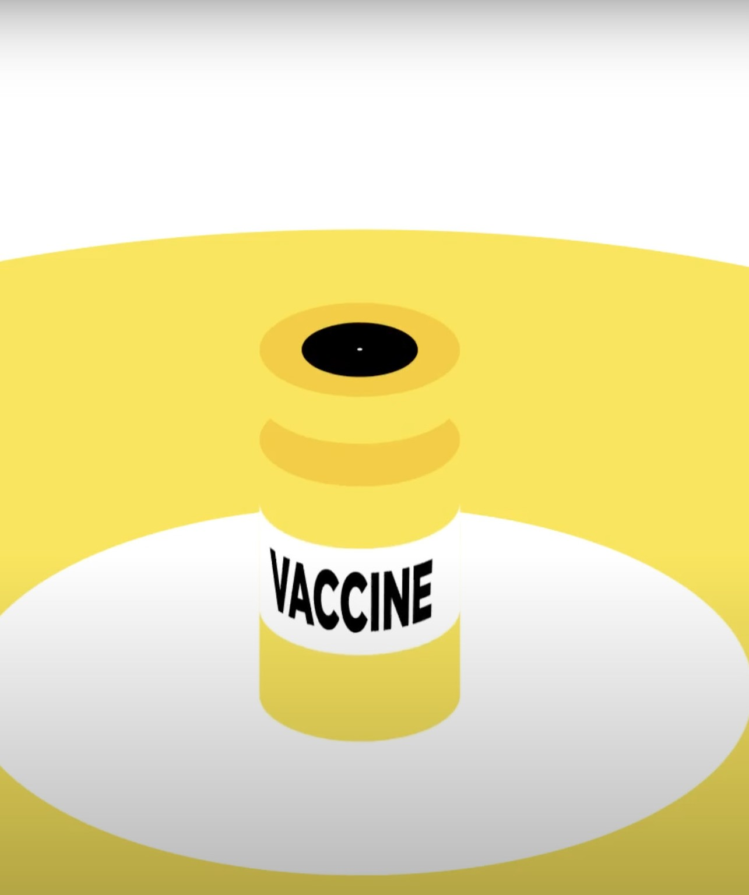
HPV and
the HPV vaccine
Notes:
Opening slide

Slide 2

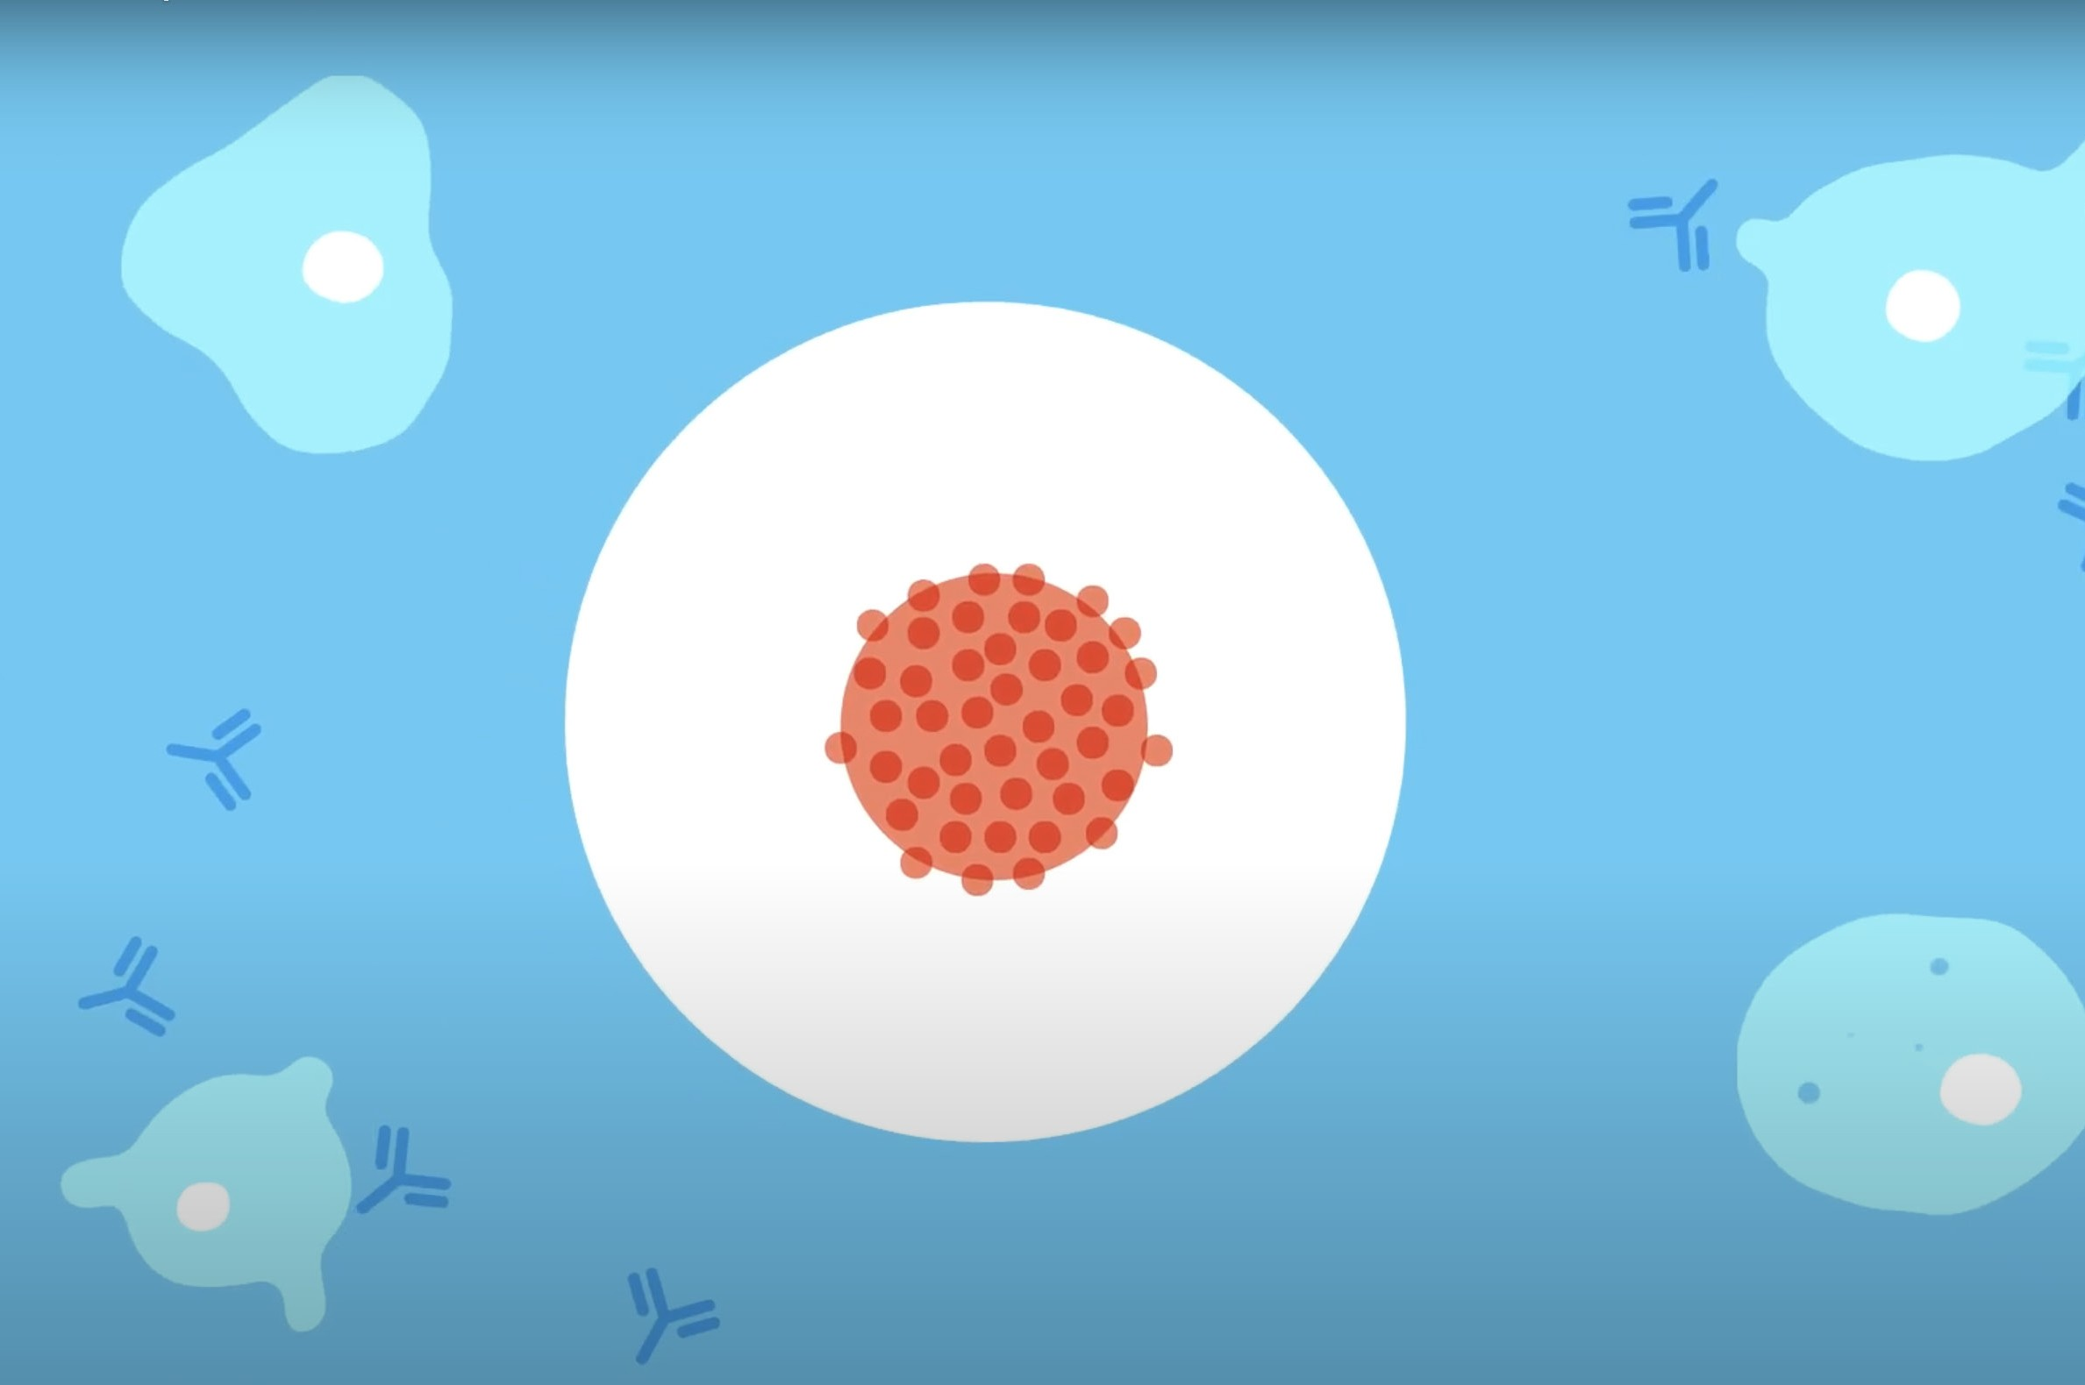



Objective:
To learn about what the HPV vaccine is and what happens on the day of the vaccination
Learning outcomes:
Explain what the HPV vaccine is and how it can provide protection
Identify and challenge misconceptions regarding the HPV vaccine
Describe what happens when someone receives the HPV vaccination
Notes:
Introduction to the lesson
Explain the objectives for the lesson.
Students will be able to
Explain what the HPV vaccine is and how it can provide protection
Identify and challenge misconceptions regarding the HPV vaccine
Describe what happens when someone receives the HPV vaccination

Slide 3
Group agreement:
We will listen to each other
All questions are welcome in this class
If we don’t know the correct terms to use, we will ask the teacher
If something that is said needs to be referred to a member of the safeguarding team, our teacher will do so
Notes:
Introduction to the lesson
The group agreement is included as the package could raise sensitive issues (e.g. sexual behaviours).
This is intended to be discussed with attendees at the beginning, and then confirmed again at the end, of the session.
Young people could also be offered the opportunity to add their own ground rules if they wish.

Slide 4
Group agreement:
We will respect what other
people say
We will ask questions if we aren’t sure of something
We won’t share our own, or our friends’, personal experiences, or share what has been said outside of the classroom
Notes:
Introduction to the lesson
The group agreement is included as the package could raise sensitive issues (e.g. sexual behaviours).
This is intended to be discussed with attendees at the beginning, and then confirmed again at the end, of the session.
Young people could also be offered the opportunity to add their own ground rules if they wish.

Slide 5
What does HPV stand for?
Notes:
Answer on subsequent slide.

Slide 6
What does HPV stand for?
Human Papillomavirus

Slide 7
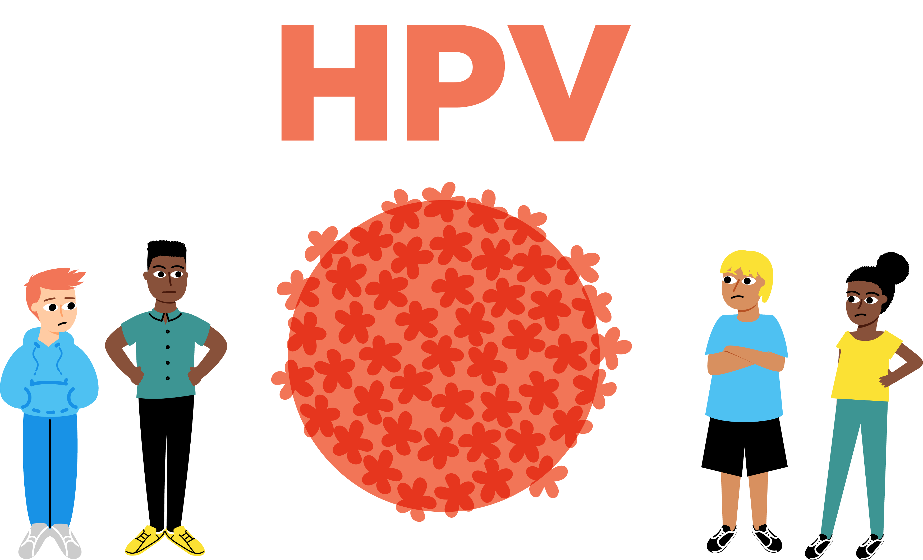

What is HPV?
HPV is a virus that can affect everyone
It is spread by
skin-to-skin contact, especially in the genital area
Usually it leaves the body naturally
Notes:
Additional information:
There are no symptoms of HPV.
Most of the time we don’t even know we have had HPV or have any health problems because of it.
Symptoms related to cancer may present after many years.

Slide 8
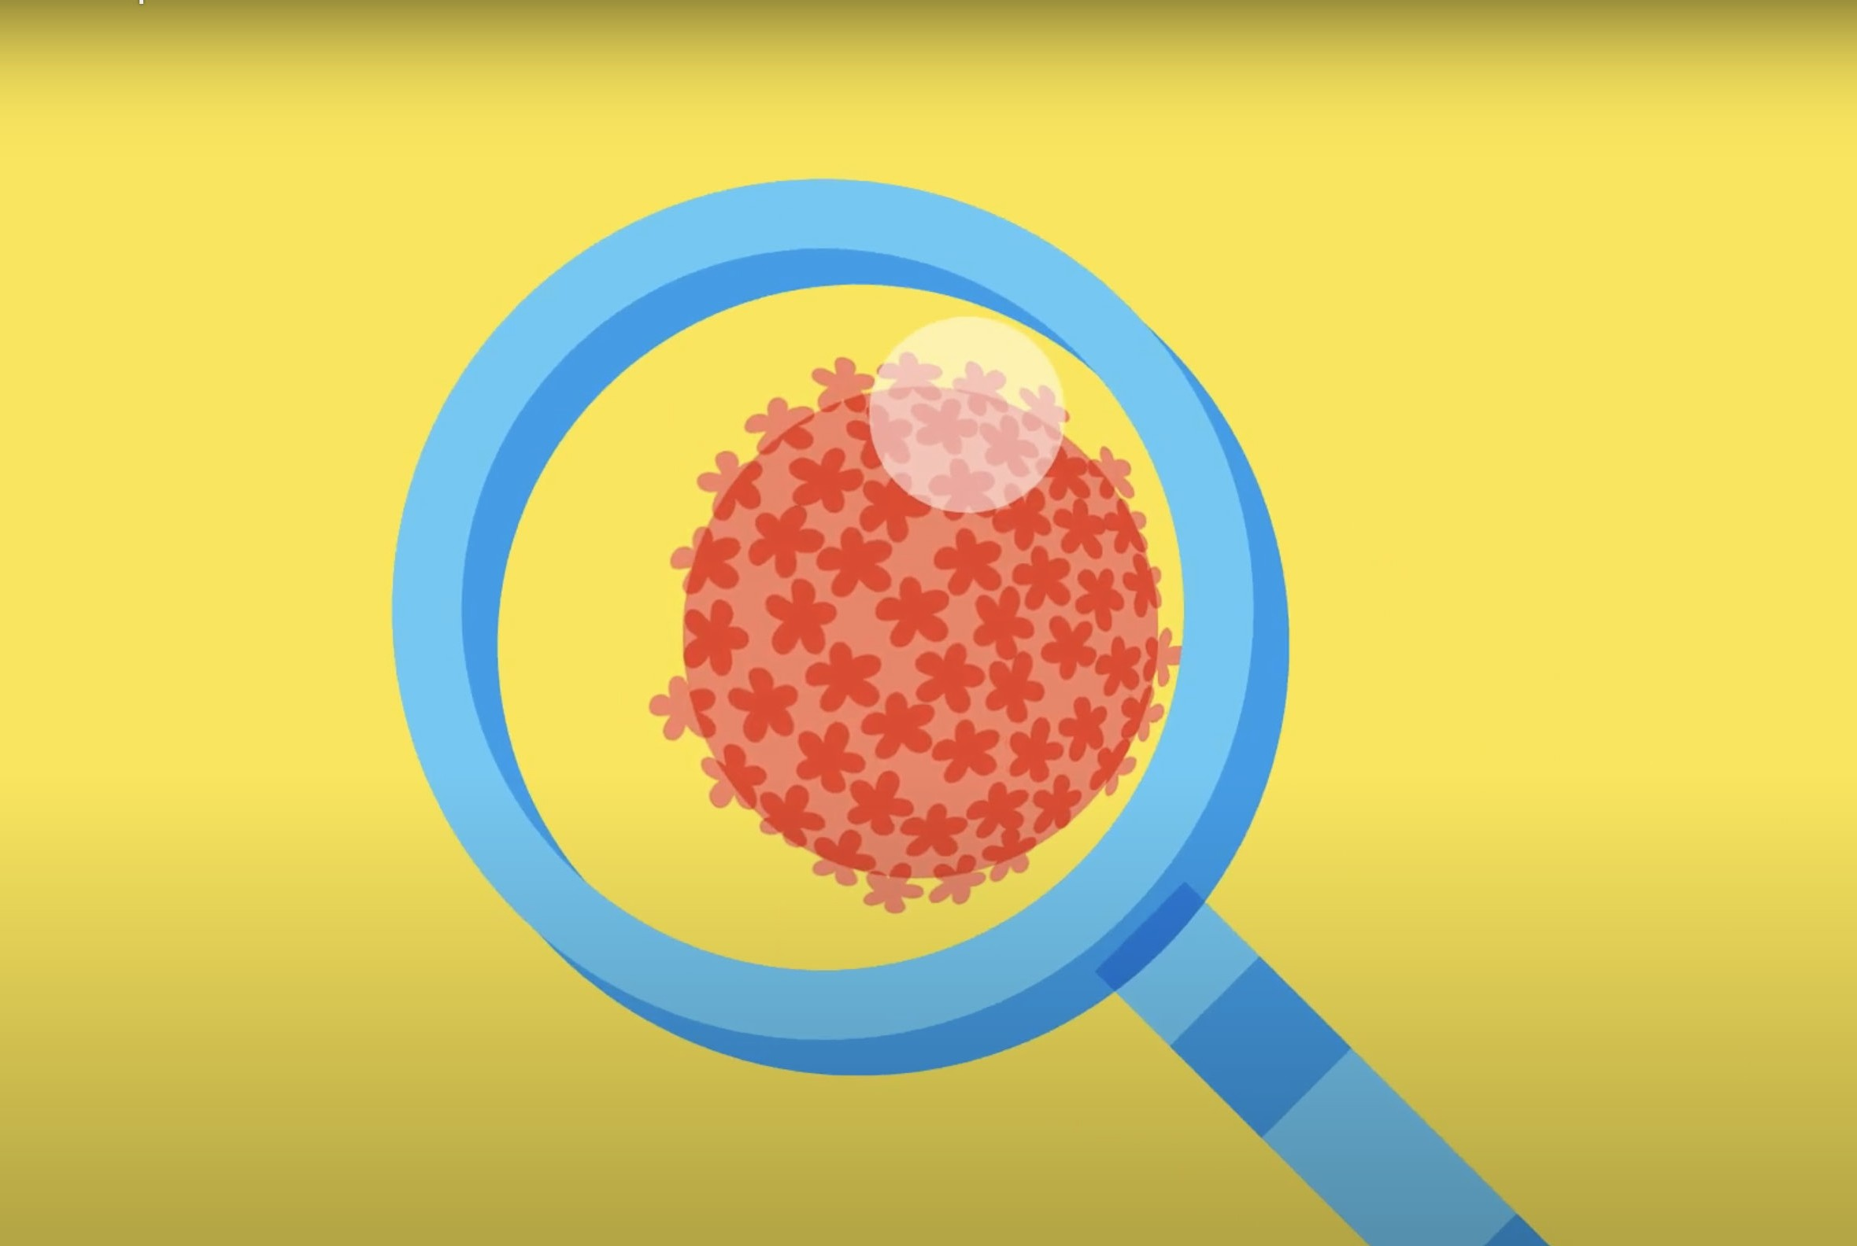
How common is HPV?
It is very common
Without a vaccination programme, 4 in 5 people will be infected with HPV over their lifetime

Slide 9


HPV and the immune system
Notes:
HPV and the immune system
Play the animation (Film One) to the students. It covers key information and questions young people may have about HPV and the immune system.
Provide young people with the questions provided in Activity One worksheet to complete while the video is being played. You may wish to pause the video to allow for students to complete the worksheet.
Questions
What happens if an infection with HPV does not clear naturally?
How can someone find out if they have HPV?
Is there a cure for HPV?
How can someone protect themselves from HPV?

Slide 10
Activity: HPV and the immune system
What happens if an infection with HPV does not clear naturally?
How can someone find out if they have HPV?
Is there a cure for HPV?
How can someone protect themselves from HPV?
Notes:
Core Activity One – HPV and the immune system
After the video has been played, ask volunteers to share their answers to the four questions.
1) What happens if an infection with HPV does not clear naturally?
Persistent infection with HPV can lead to genital warts and cancers affecting the mouth, throat, anal and genital areas of men and women.
2) How can someone find out if they have HPV?
Most of the time people do not know they have HPV. Women can get tested when they attend for their cervical cancer screening programme.
3) Is there a cure for HPV?
There is no cure for HPV. However, there are treatments for the effects of HPV.
4) How can someone protect themselves from HPV?
Having the HPV vaccine is the best way to be protected from HPV.

Slide 11
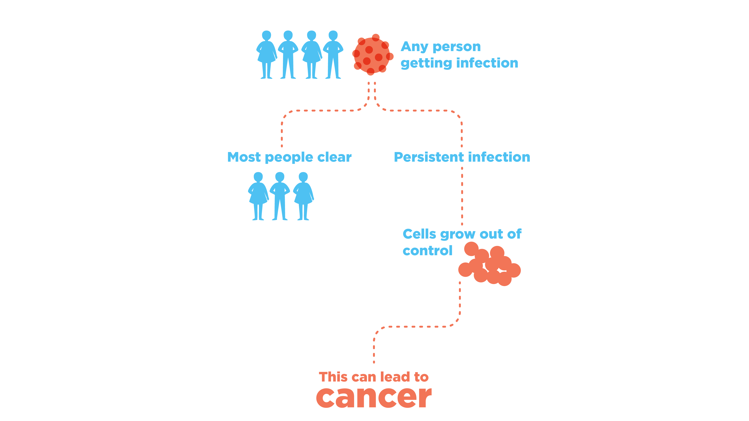
How HPV can lead to cancer
Slide11
Notes:
Image adapted from Cancer Research UK.
This slide is intended to explain how an infection with HPV can lead to different types of cancer.
It is important to stress to young people that in the majority of cases, the infection will clear without symptoms.
Only in rare cases will an infection lead to cancer.

Slide 12
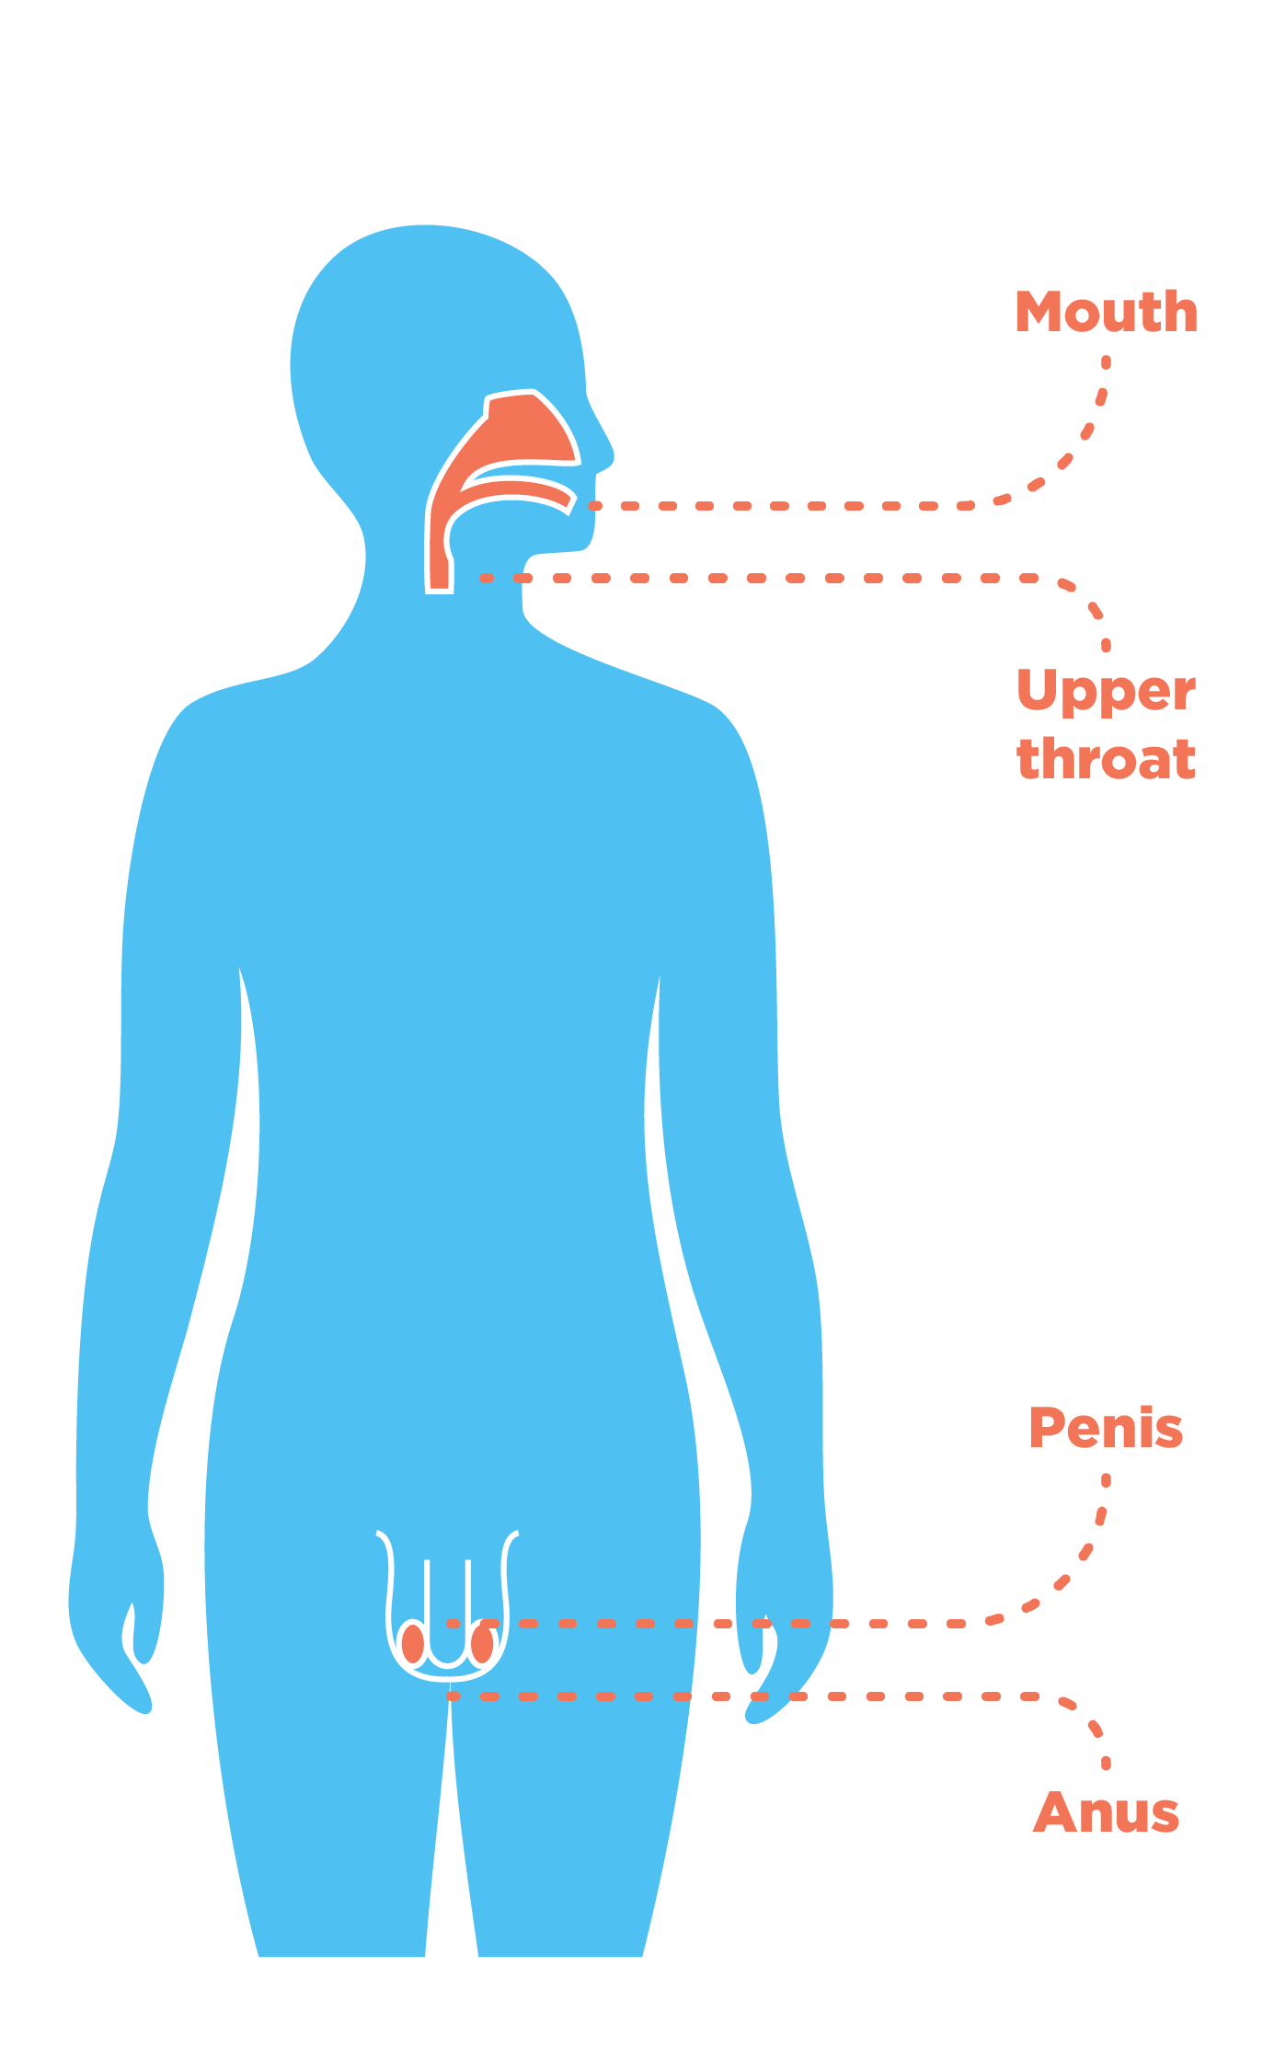
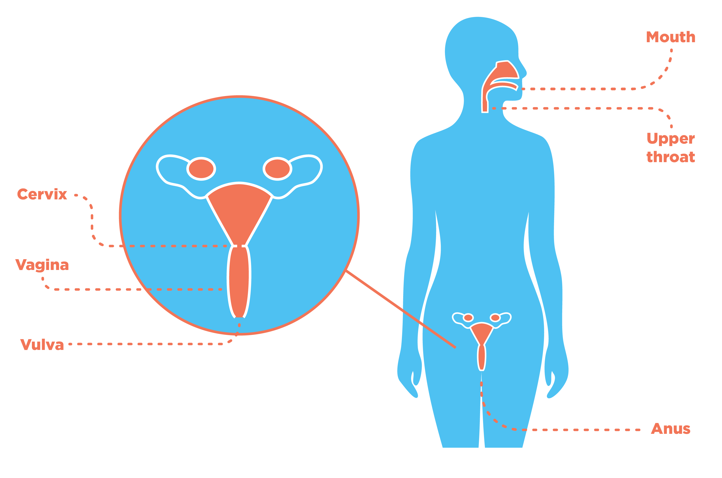
Body parts affected by HPV-related cancers
Cervical cancer is the most commonly occurring HPV-related cancer
Notes:
HPV related cancers include:
Cervical cancer
Vaginal cancer
Vulval cancer
Anal cancer
Cancer of the penis
Some cancers of the head and neck
Cervical cancer is the most widely occurring HPV-related cancer.
Often young people are unclear where the cervix is. This can be clarified during the session through the close up of female anatomy.

Slide 13
Question break
Notes:
Suggested opportunity for young people to ask any questions they may have.
Please see accompanying guidance for FAQs and suggested responses.

Slide 14
Steve’s Story
Notes:
Film 2. This film involves a case-study of HPV-related throat cancer survivor.
You may wish to ask if any of the students are going to find the topic area upsetting as the content of the video may be difficult for some young people to watch, especially if they have family members who are undergoing cancer treatment.

Slide 15
Reflection break How does this make you feel? What does this make you think? Any comments or questions?
Notes:
Opportunity for young people to debrief after film.

Slide 16
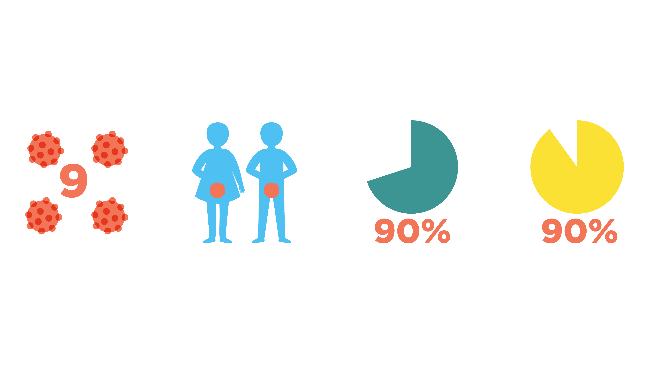
What does the HPV vaccine protect against?
The nine strains of HPV that cause most cases of cancer
Mouth, throat and genital cancers
90% of cases of cervical cancer
90% of cases of
genital warts
In the majority of cases, an infection with HPV will clear without symptoms
Notes:
Explain that there are over 100 types of HPV. The HPV vaccine protects against the nine strains of HPV that cause the most cases of cancer.
Provide reassurance to students that in the majority of cases an infection with HPV will clear without symptoms.

Slide 17

How
effective is the HPV vaccine?
It is a very effective vaccine
It will prevent 99% of infections caused by the strains of HPV it protects against
Notes:
The HPV vaccine is one of the most effective vaccines available.

Slide 18
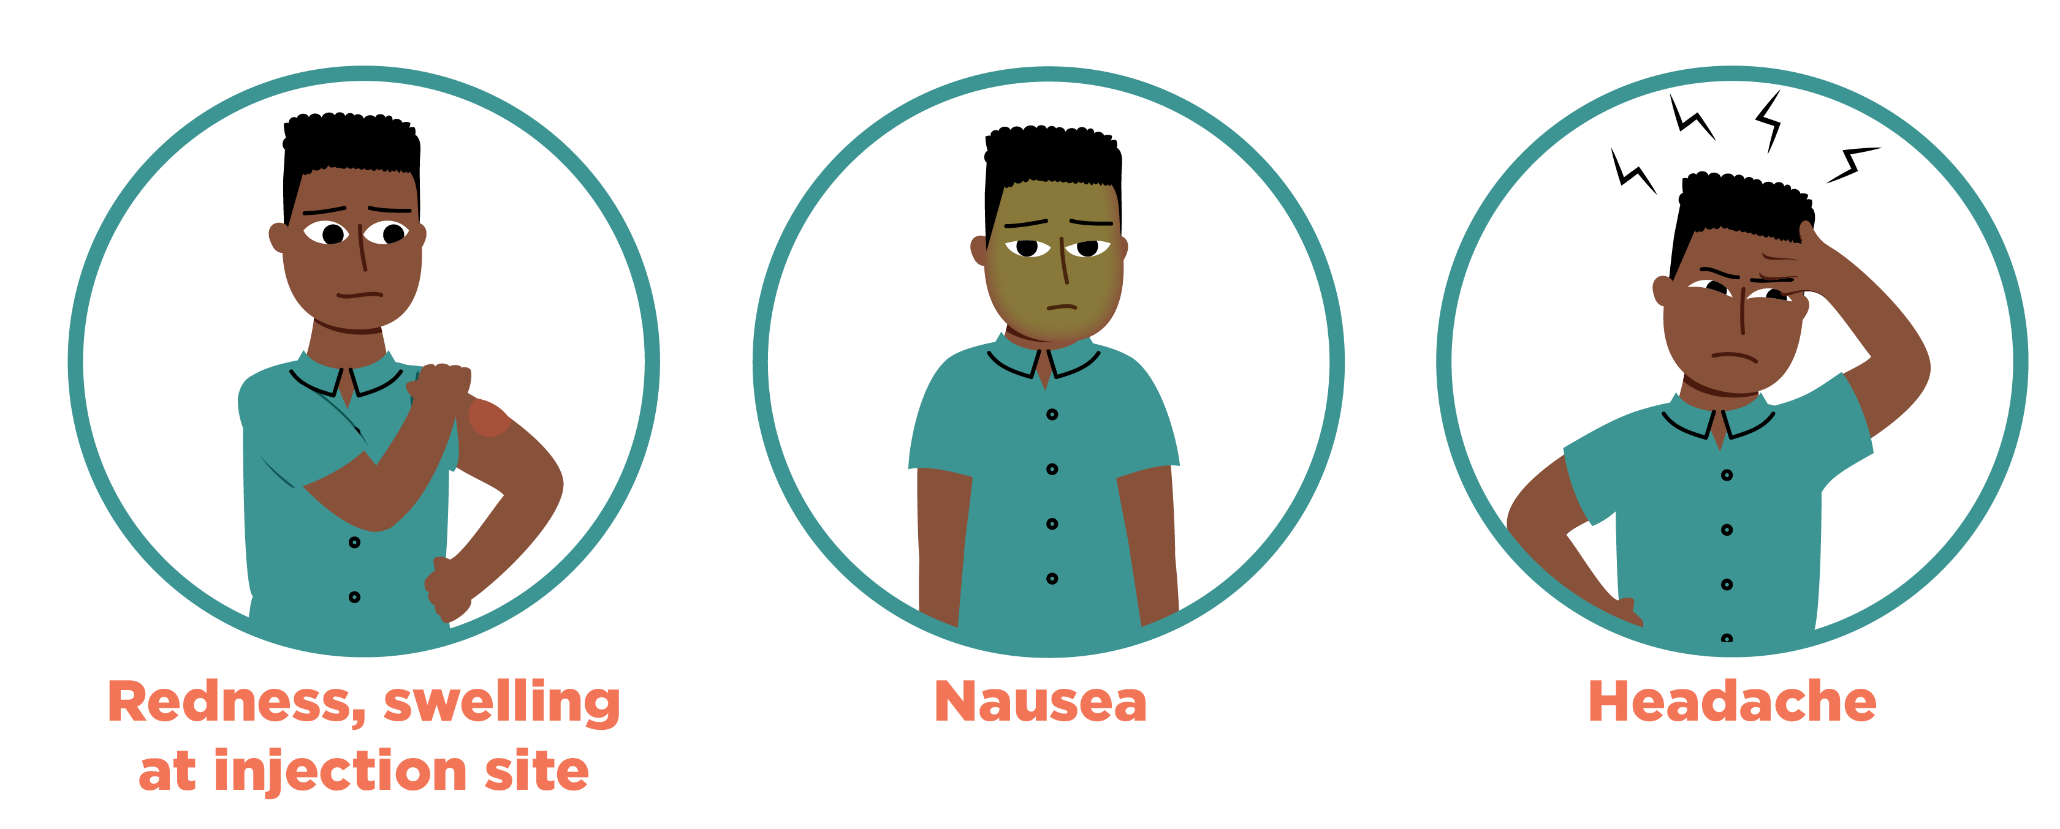
Are there any side-effects?
There might be some minor side-effects
These are normal and shouldn’t last more than a day or two
Only around 1 in 100 people will develop nausea
Notes:
Young people are likely to be worried about the side-effects. Young people told us it was important to be honest about mild side-effects, but it wouldn’t be helpful to focus on more rare side-effects unless young people specifically ask.
Stress to young people that by having the HPV vaccine they will be protected against much more serious health problems.
As with any medication, there is always the risk of side-effects developing. Most people experience a small amount of pain at the vaccination site. It can be helpful to stress to young people that this will be over really quickly!
Young people could expect that their arm might be a bit sore that day, but by the next day it should be fine.
They may notice the vaccination site is a little bit red and their arm is a bit achy for the rest of the day. That’s normal too and shows your body is having an immune response to the vaccine.
Around 1 in 10 people who receive the HPV vaccine will experience redness or soreness.
Around 1 in 100 people will experience nausea.
The immunisation team are trained to spot and deal with any more serious problems.
The HPV is one of the safest vaccines available. However, around one in a million young people may have an allergic reaction to the vaccine. The nurses are trained to deal with this and carry medication to treat this immediately, if this happens.
For more detailed information about side-effects, please see this website: https://www.nhs.uk/conditions/vaccinations/hpv-vaccine-cervarix-gardasil-side-effects/

Slide 19
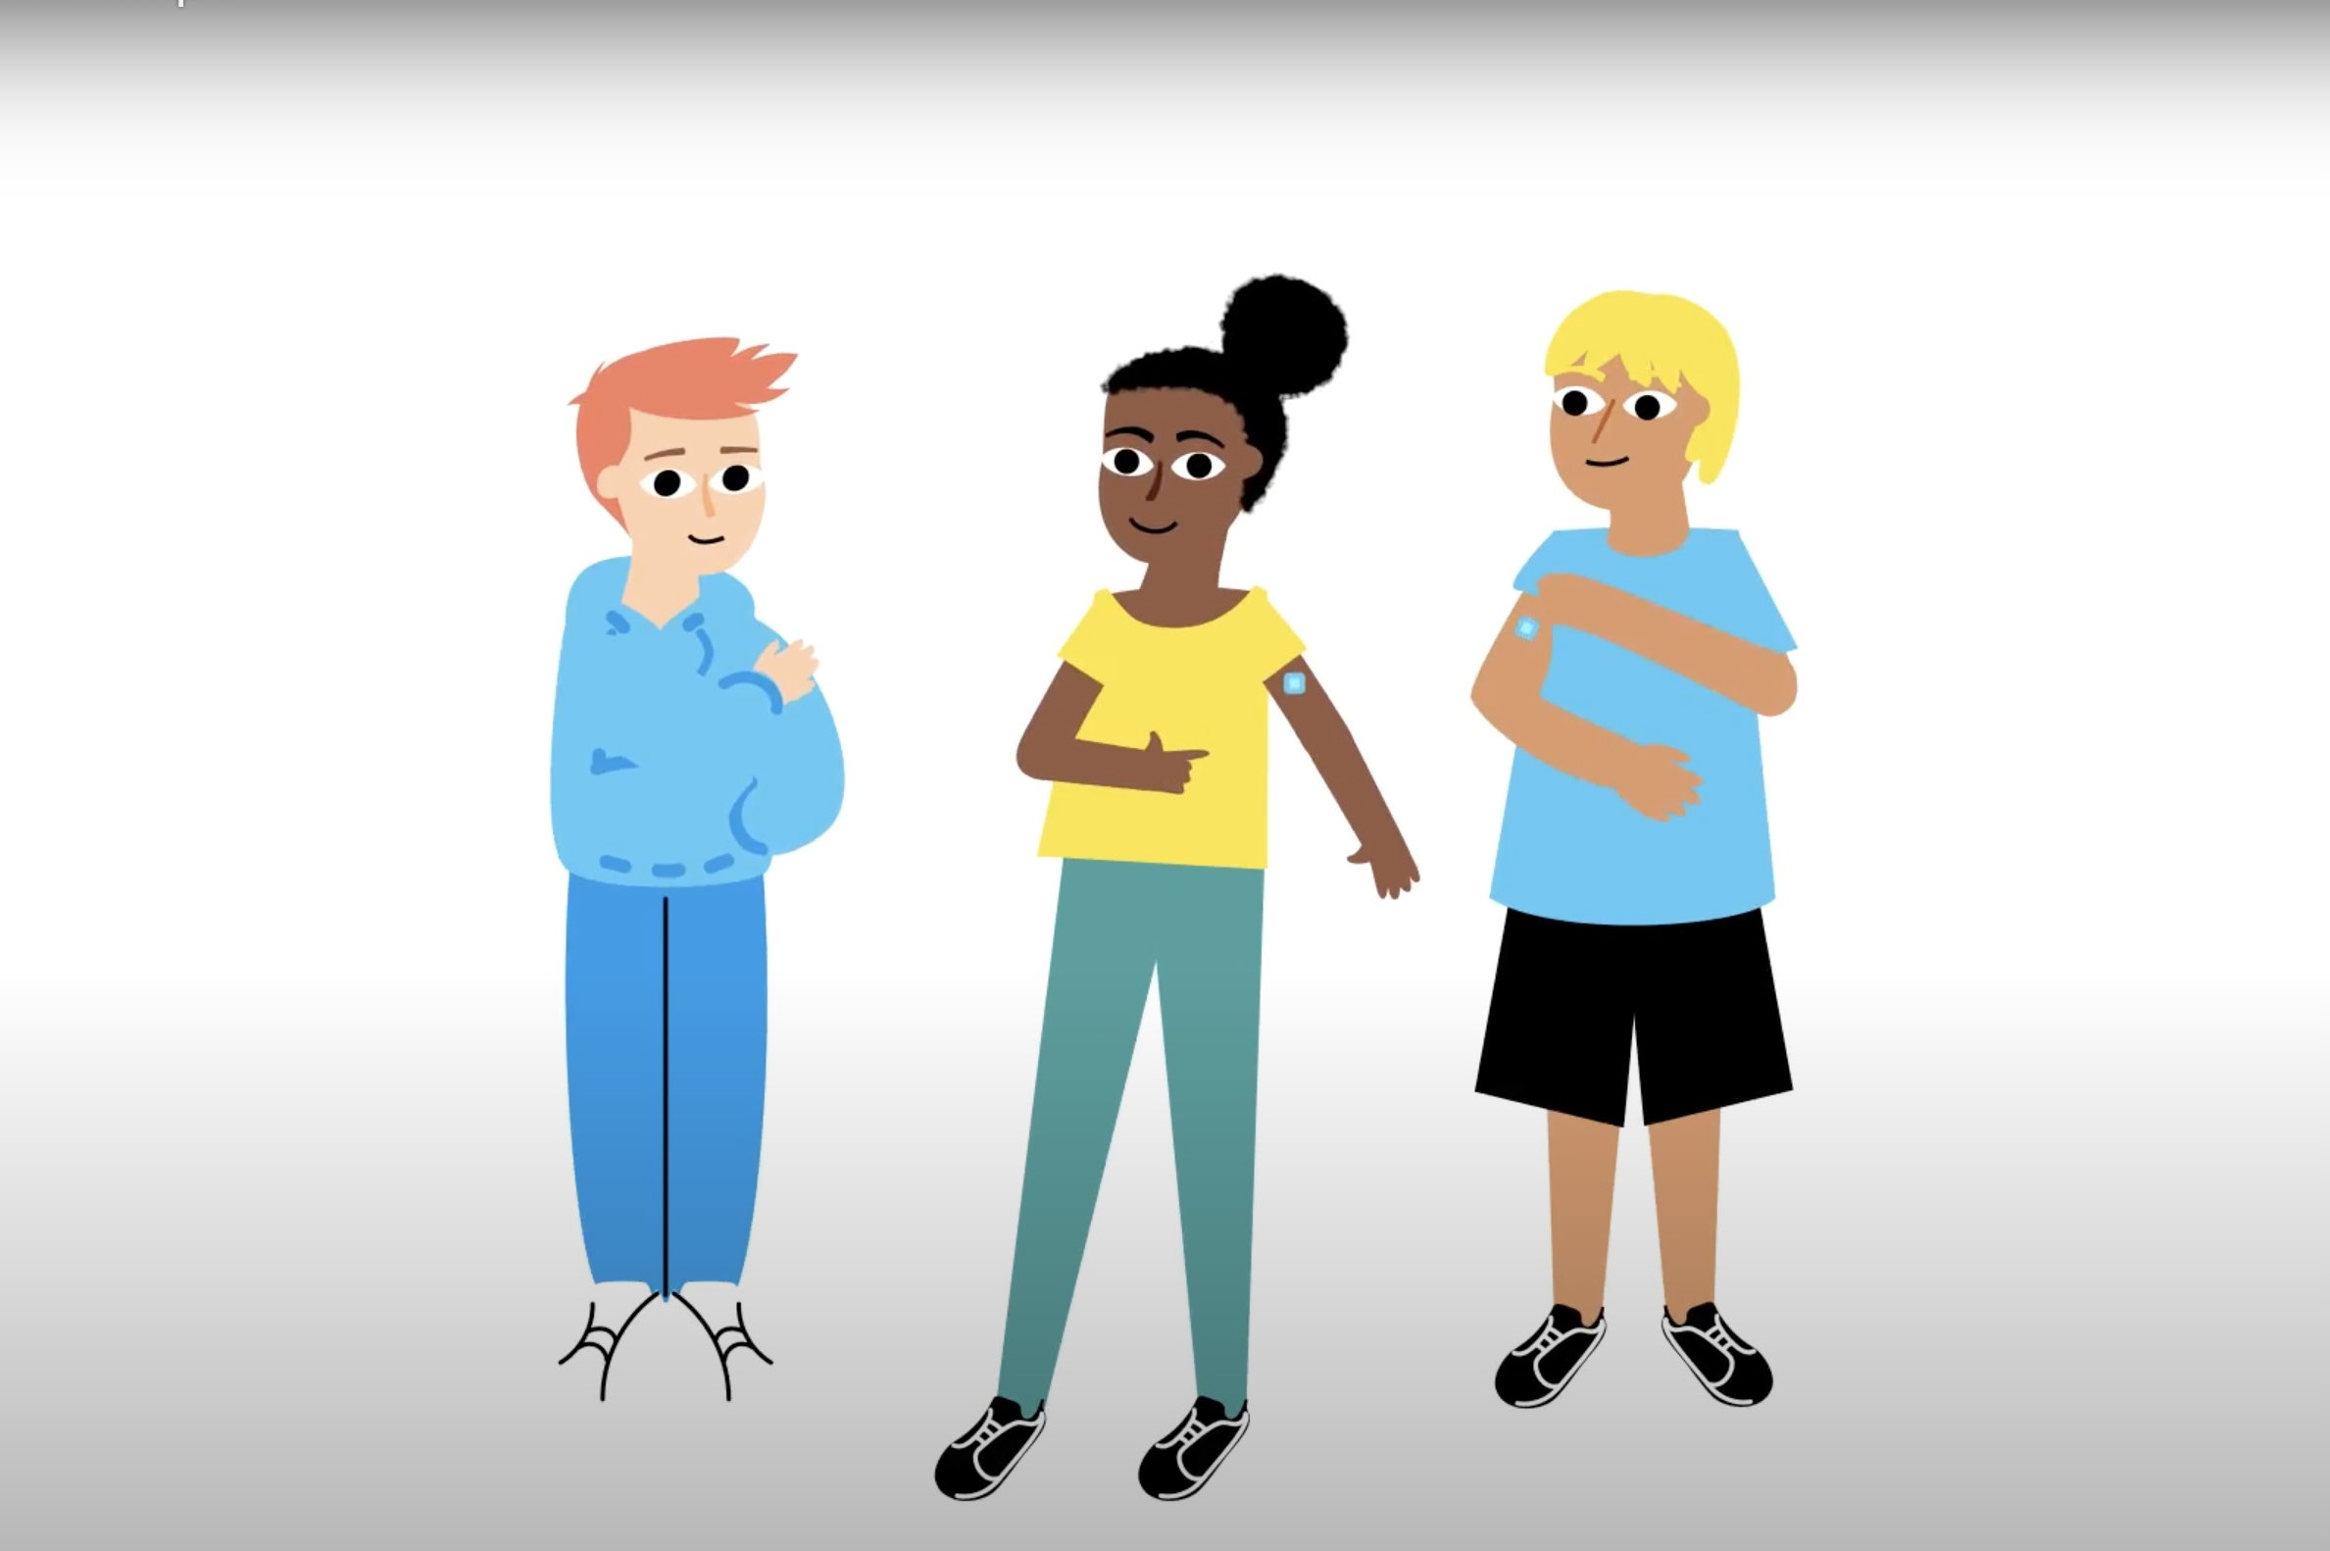
Is the vaccine safe?
Yes, the vaccine is safe
Millions of doses have been given worldwide
Notes:
The HPV vaccine is one of the safest vaccines available.

Slide 20

What is in the vaccine?
The vaccine contains particles which look like the outside of the real HPV
It also contains some other ingredients to make the vaccine suitable for injection
The vaccine does not
contain pork or gelatine
Notes:
The vaccine contains particles which look like the outside of the real HPV.
It also contains some other ingredients to keep the vaccine suitable for injection.
The vaccine does not contain pork or gelatine.
The vaccine does not contain live or killed viruses. That means it cannot cause cancer or other HPV-related illnesses.

Slide 21
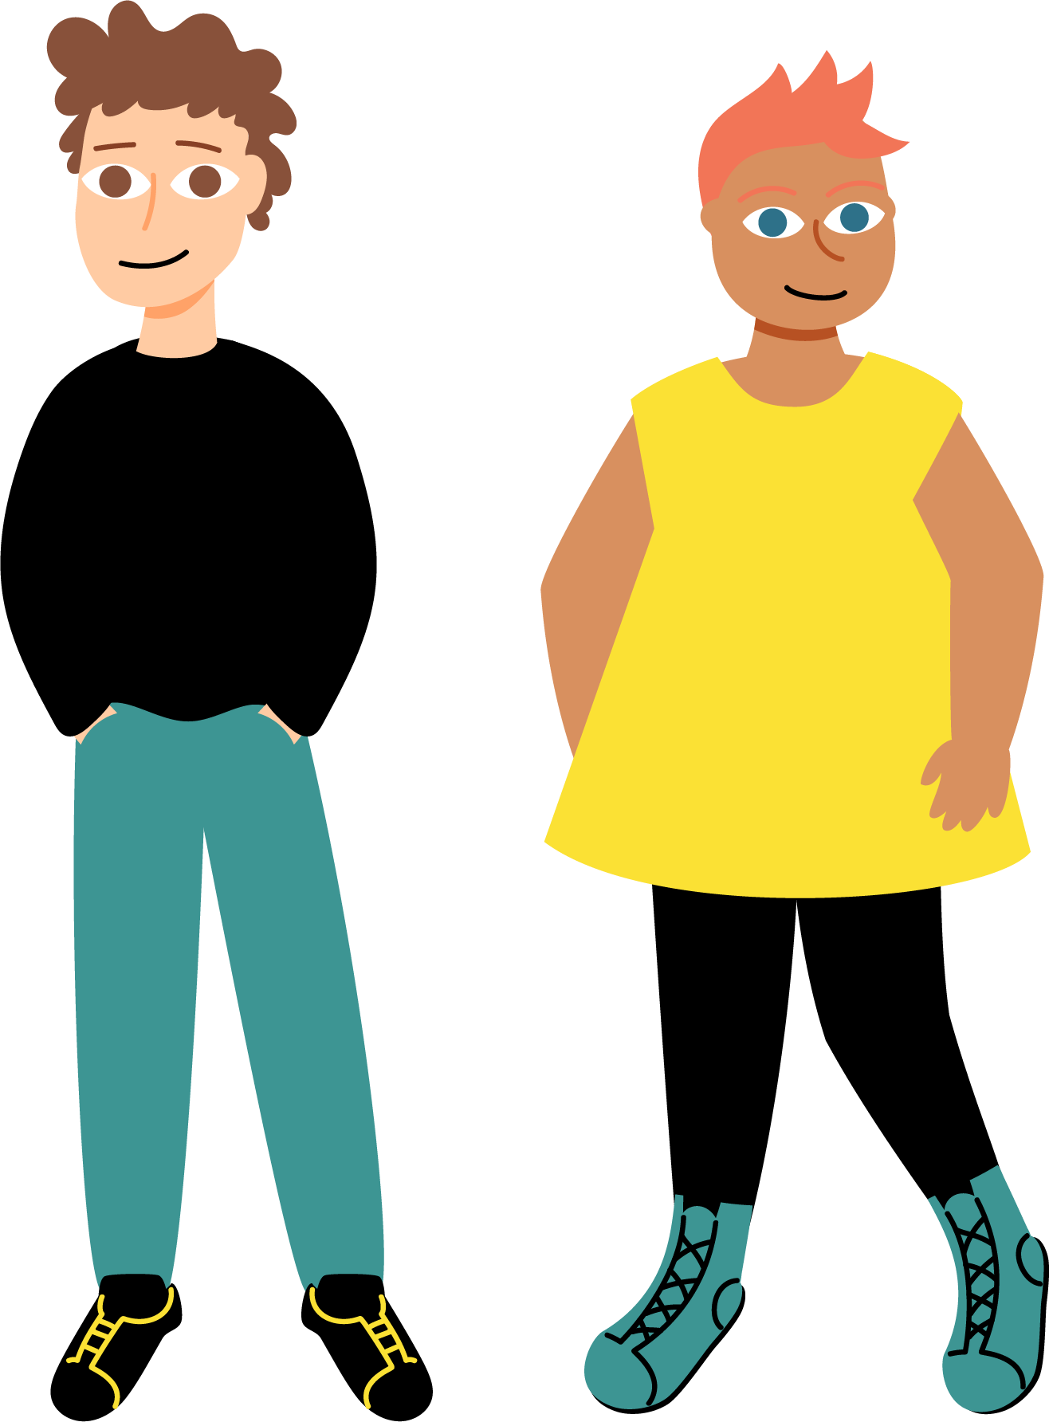
Who can have the HPV vaccine?
Students are offered the HPV vaccine early in secondary school as this is a good time to have it
If someone miss having the vaccine at school, they can also have the HPV vaccine at your general practice until they are 25 years old
The vaccine is also available for men-who- have-sex-with-men until they are aged 45 years
Notes:
In England, young women were first offered the HPV vaccine in 2008. This was to help protect young women from developing cervical cancer. There is now more scientific evidence which shows that men can be affected by cancers that are caused by HPV.
In 2019, the government decided to offer young men the vaccine as well so they can benefit from protection against HPV.
It is important that you have the vaccine before you have been exposed to the virus. Even if you don’t think you need the vaccine right now, it’s best that you get the vaccine now so you definitely get the best protection.
It’s really easy to get the vaccine now. Your school will make all the arrangements with the immunisation team so that everybody can get the vaccine.

Slide 22

What to expect at the HPV vaccine session
Notes:
Show Film 3 (What to expect at the HPV vaccine session). After the film is shown, provide context specific information about how the session will run in their school. For example:
Date of vaccination session
Consent procedure
Location of vaccination session
Name of staff member co-ordinating the session

Slide 23
Question break
Notes:
The next film will involve young people asking the immunisation nurse their questions about vaccination.

Slide 24

Questions with an immunisation nurse
Notes:
Film Four. Questions and answers with an immunisation nurse
Play this film which shows young people asking the immunisation nurse their questions about vaccination.

Slide 25
Tips for the day of the vaccination
If someone is feeling nervous, they can ask to be vaccinated first
Keep distracted
Talk to the person giving the vaccine
Notes:
Stress to young people that they shouldn’t worry. It won’t be as bad as they think and the nurses are really nice. Young people say that the worst bit is waiting around for the vaccine beforehand.
It’s a sharp scratch for hardly any time all. Then you will know you’re protected against the main types of HPV.
If the young person is feeling a bit nervous they could be encouraged to tell their teacher to see if they can have the vaccine before the other students.
Other tips include taking some big deep breaths to keep feeling calm and distract themselves. Or they could try counting backwards from 100.
Young people could be invited to provide their own tips for having the vaccination session.

Slide 26
Tips for the day of the vaccination
Eat something before having the vaccine
Wear a short sleeved or loose sleeved top
If someone wears a long sleeved top, they don’t need to worry. Everyone’s privacy will be protected
Notes:
Stress to young people that they shouldn’t worry. It won’t be as bad as they think and the nurses are really nice. Young people say that the worst bit is waiting around for the vaccine beforehand.
It’s a sharp scratch for hardly any time all. Then you will know you’re protected against the main types of HPV.
If the young person is feeling a bit nervous they could be encouraged to tell their teacher to see if they can have the vaccine before the other students.
Other tips include taking some big deep breaths to keep feeling calm and distract themselves. Or they could try counting backwards from 100.
Young people could be invited to provide their own tips for having the vaccination session.

Slide 27

Reassurance strategies
Notes:
Film 5. This film covers young people providing suggestions for how to improve their experience of having the HPV vaccine.

Slide 28
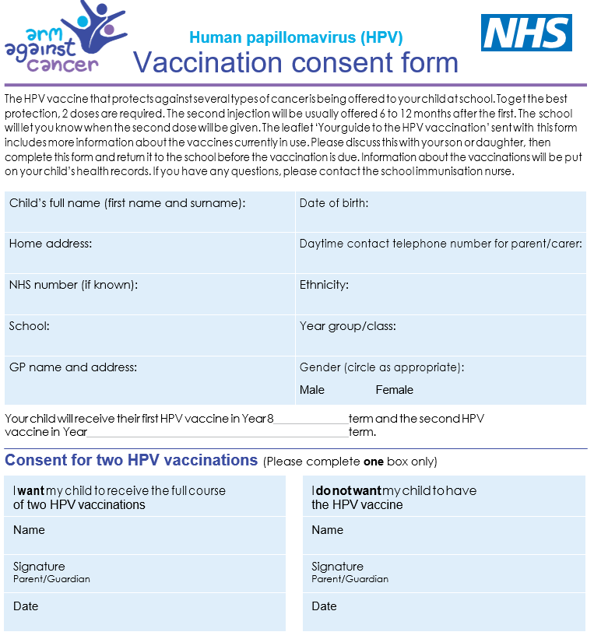
Getting the vaccine
Information leaflets and consent forms will be provided (either electronically or paper) by the school
Parents/carers are asked to complete the consent form and return it to the school
Notes:
If possible, this session could be provided at the time consent forms are being distributed. If paper-based consent forms are used, these could be provided during the session.
Young people could be informed about any school specific instructions at this point (e.g. name of staff member co-ordinating the session).

Slide 29
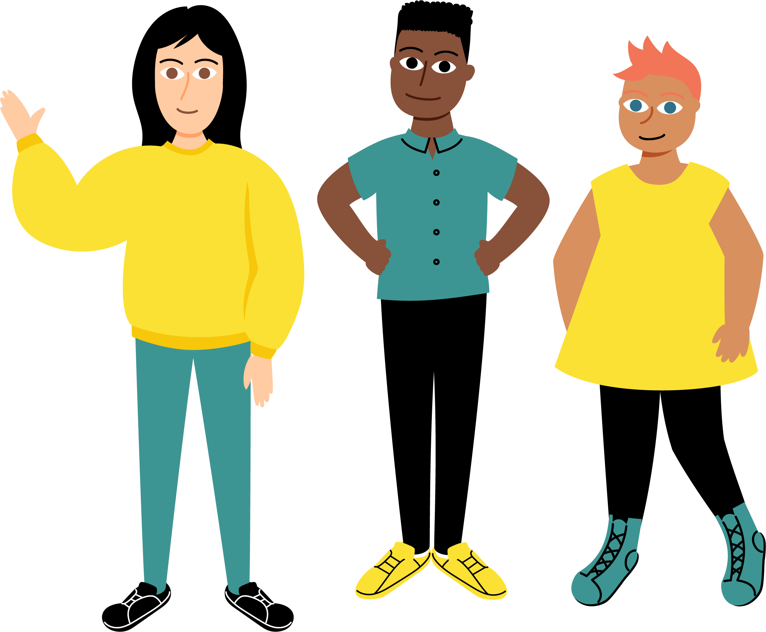
Young people’s consent
We recommend young people get agreement from their parent/carer, but it isn’t always necessary
For more information about young people’s consent, young people can talk to their school nurse / medical officer
Notes:
By law, young people under the age of 16 are allowed to consent to medical treatments, including vaccines, as long as they fully understood what is involved and are confident about their decision.
If at all possible, it is best that parents and young people decide about having the HPV vaccine together. However, if this isn’t possible, young people should be advised to talk to their immunisation nurse who can advise them.
There is more information about young people’s right to consent for vaccination here: https://www.nhs.uk/conditions/consent-to-treatment/children/

Slide 30
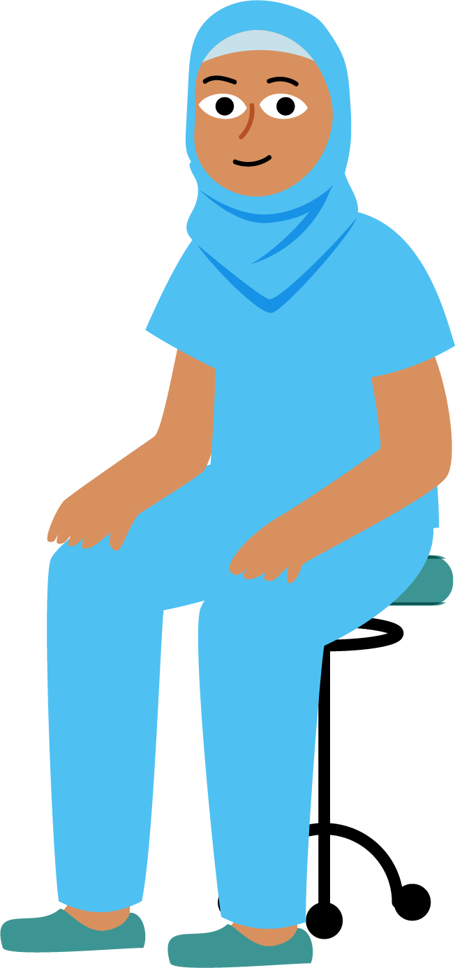
What should someone do if they miss having the vaccine at school
If someone misses having the vaccine at school, they can talk to their school or parents/carers about arranging to have it
Visit the immunisation team at a clinic or general practice
Young people can catch up right up until their 25th birthday
Notes:
If a young person (both male and female) didn’t get the vaccine at school when they were offered it, they can get the vaccine at their GP or other community settings until they are 25 years old. Different areas may different ways and places to catch-up with the HPV vaccine.
Men-who-have-sex-with-men can get the HPV vaccine from HIV and sexual health clinics until they are aged 45 years.

Slide 31
What have we learned?
1. What are three reasons that young people should get the vaccine?
2. What are two facts about HPV that are important to know?
3. What is one piece of advice that can help young people feel better about getting the vaccine?
Notes:
End point assessment
Provide student with the Endpoint Assessment worksheet. Ask the students to write their responses in the spaces provided.
This is the final chance for young people to ask any questions they may have.
It may be worth iterating the key points about the HPV vaccine at this stage.
HPV is a very common infection that can in some cases lead to cancer.
The HPV vaccine is a safe and effective vaccine.
Getting the HPV vaccine will provide young people with protection from the strains of HPV that cause the majority of cases of cancer.

Slide 32
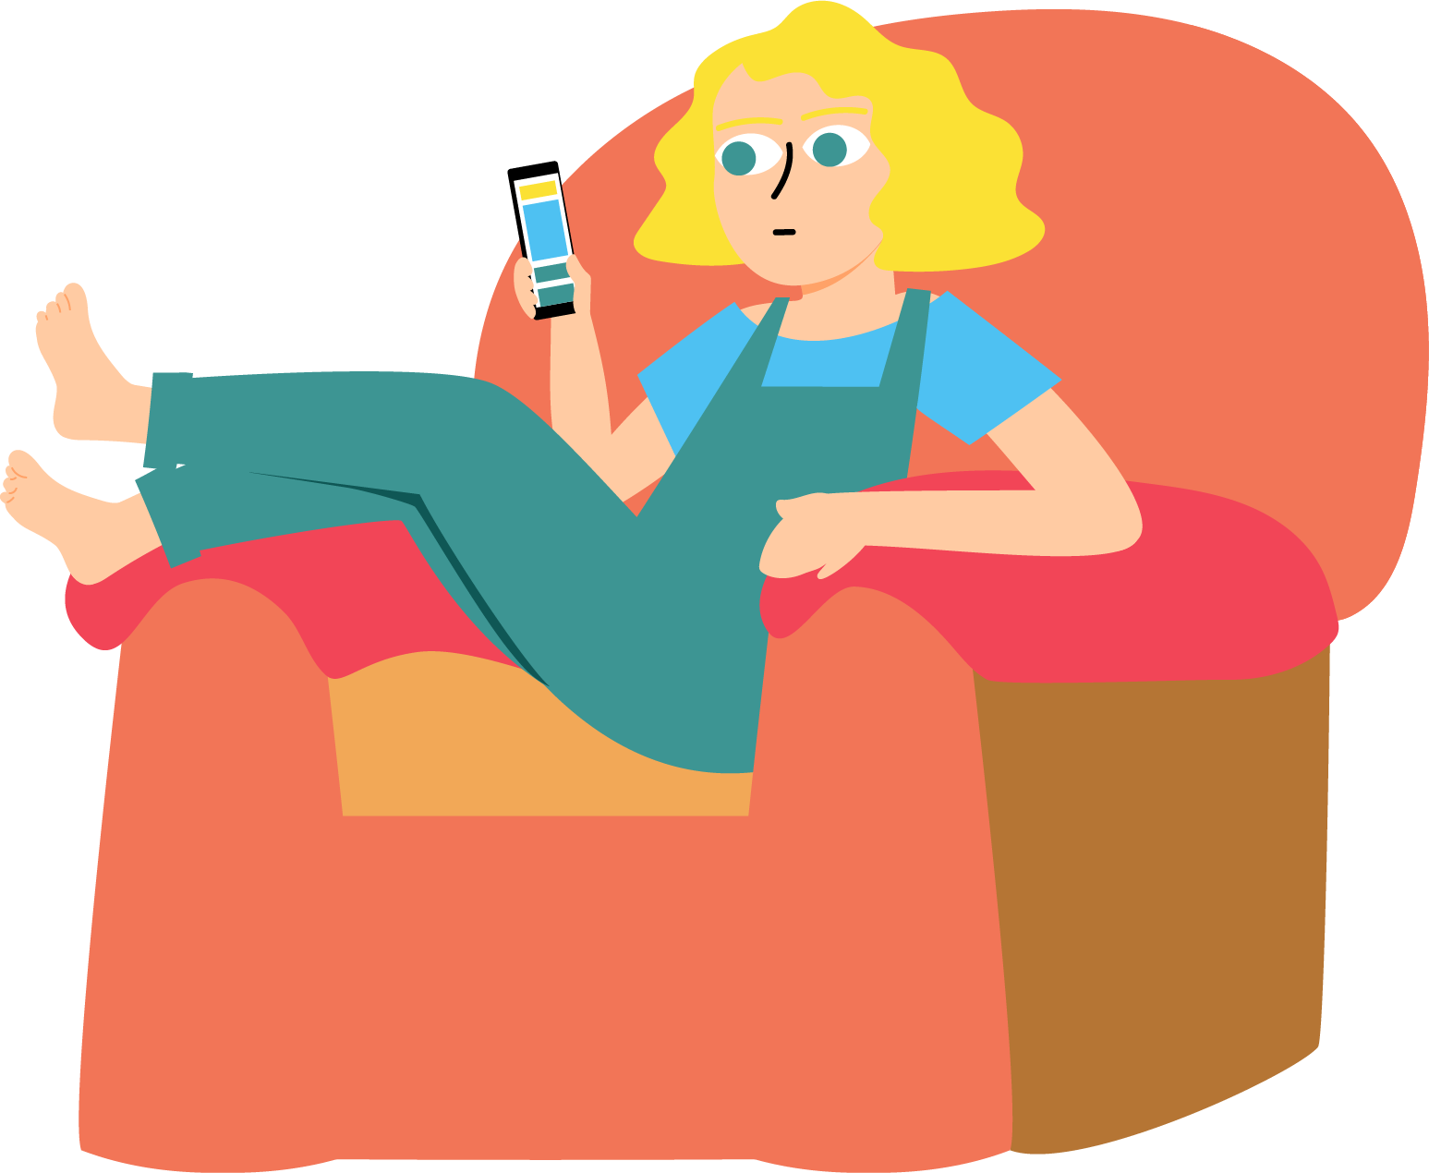
For more information about the HPV vaccine
Ask me any questions you
may have now
Speak to your school nurse or medical officer
Visit: www.healthforteens.co.uk
Visit: www.nhs.uk/
Notes:
The UK Health Security Agency publish the HPV vaccine leaflet: https://www.gov.uk/government/publications/hpv-vaccine-vaccination-guide-leaflet
On the website there is also information available in the following languages:
Albanian, Arabic, Bengali, Brazilian Portuguese, Bulgarian, Chinese, Estonian, Farsi, Greek, Gujarati, Hindi, Latvian, Lithuanian, Panjabi, Polish, Romanian, Romany, Russian, Somali, Spanish, Turkish, Twi, Ukrainian, Urdu and Yiddish.
There is a British Sign Language (BSL) video of this leaflet available to download.

Slide 33









The presentation was created as part of the EDUCATE study by researchers at the University of Bristol and London School of Hygiene and Tropical Medicine in collaboration with our partner organisations.

