Slide 1


HPV and
the HPV vaccine
Notes:
Opening slide

Slide 2
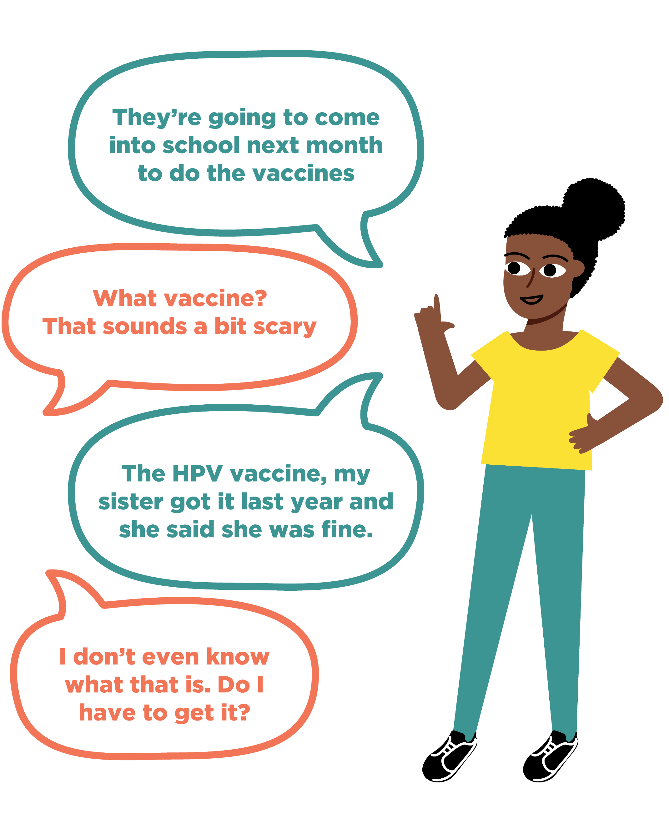
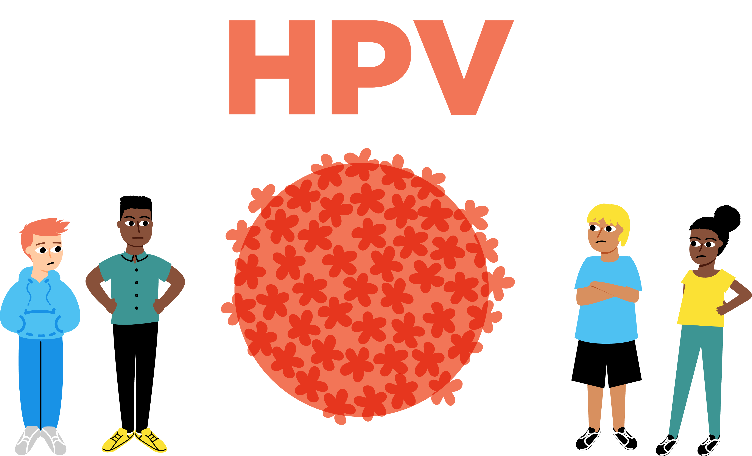


Activity: Initial thoughts
What might Micah be thinking about the vaccine? What other questions might he have?
What might Micah be feeling about getting the vaccine?
What can Micah do if he wants to know more about the vaccine?
What information can Laura give to Micah about what the HPV vaccine is?
Notes:
Baseline Assessment – Overheard conversation
As this is a baseline assessment, students should work on their own, without any further prompting or examples. If they do not know the answer to any of the questions, they can write ‘I don’t know’.
Afterwards, ask students to share their ideas as a class with you. This will allow you to gauge students’ current knowledge, understanding and beliefs, about the HPV vaccine.

Slide 3
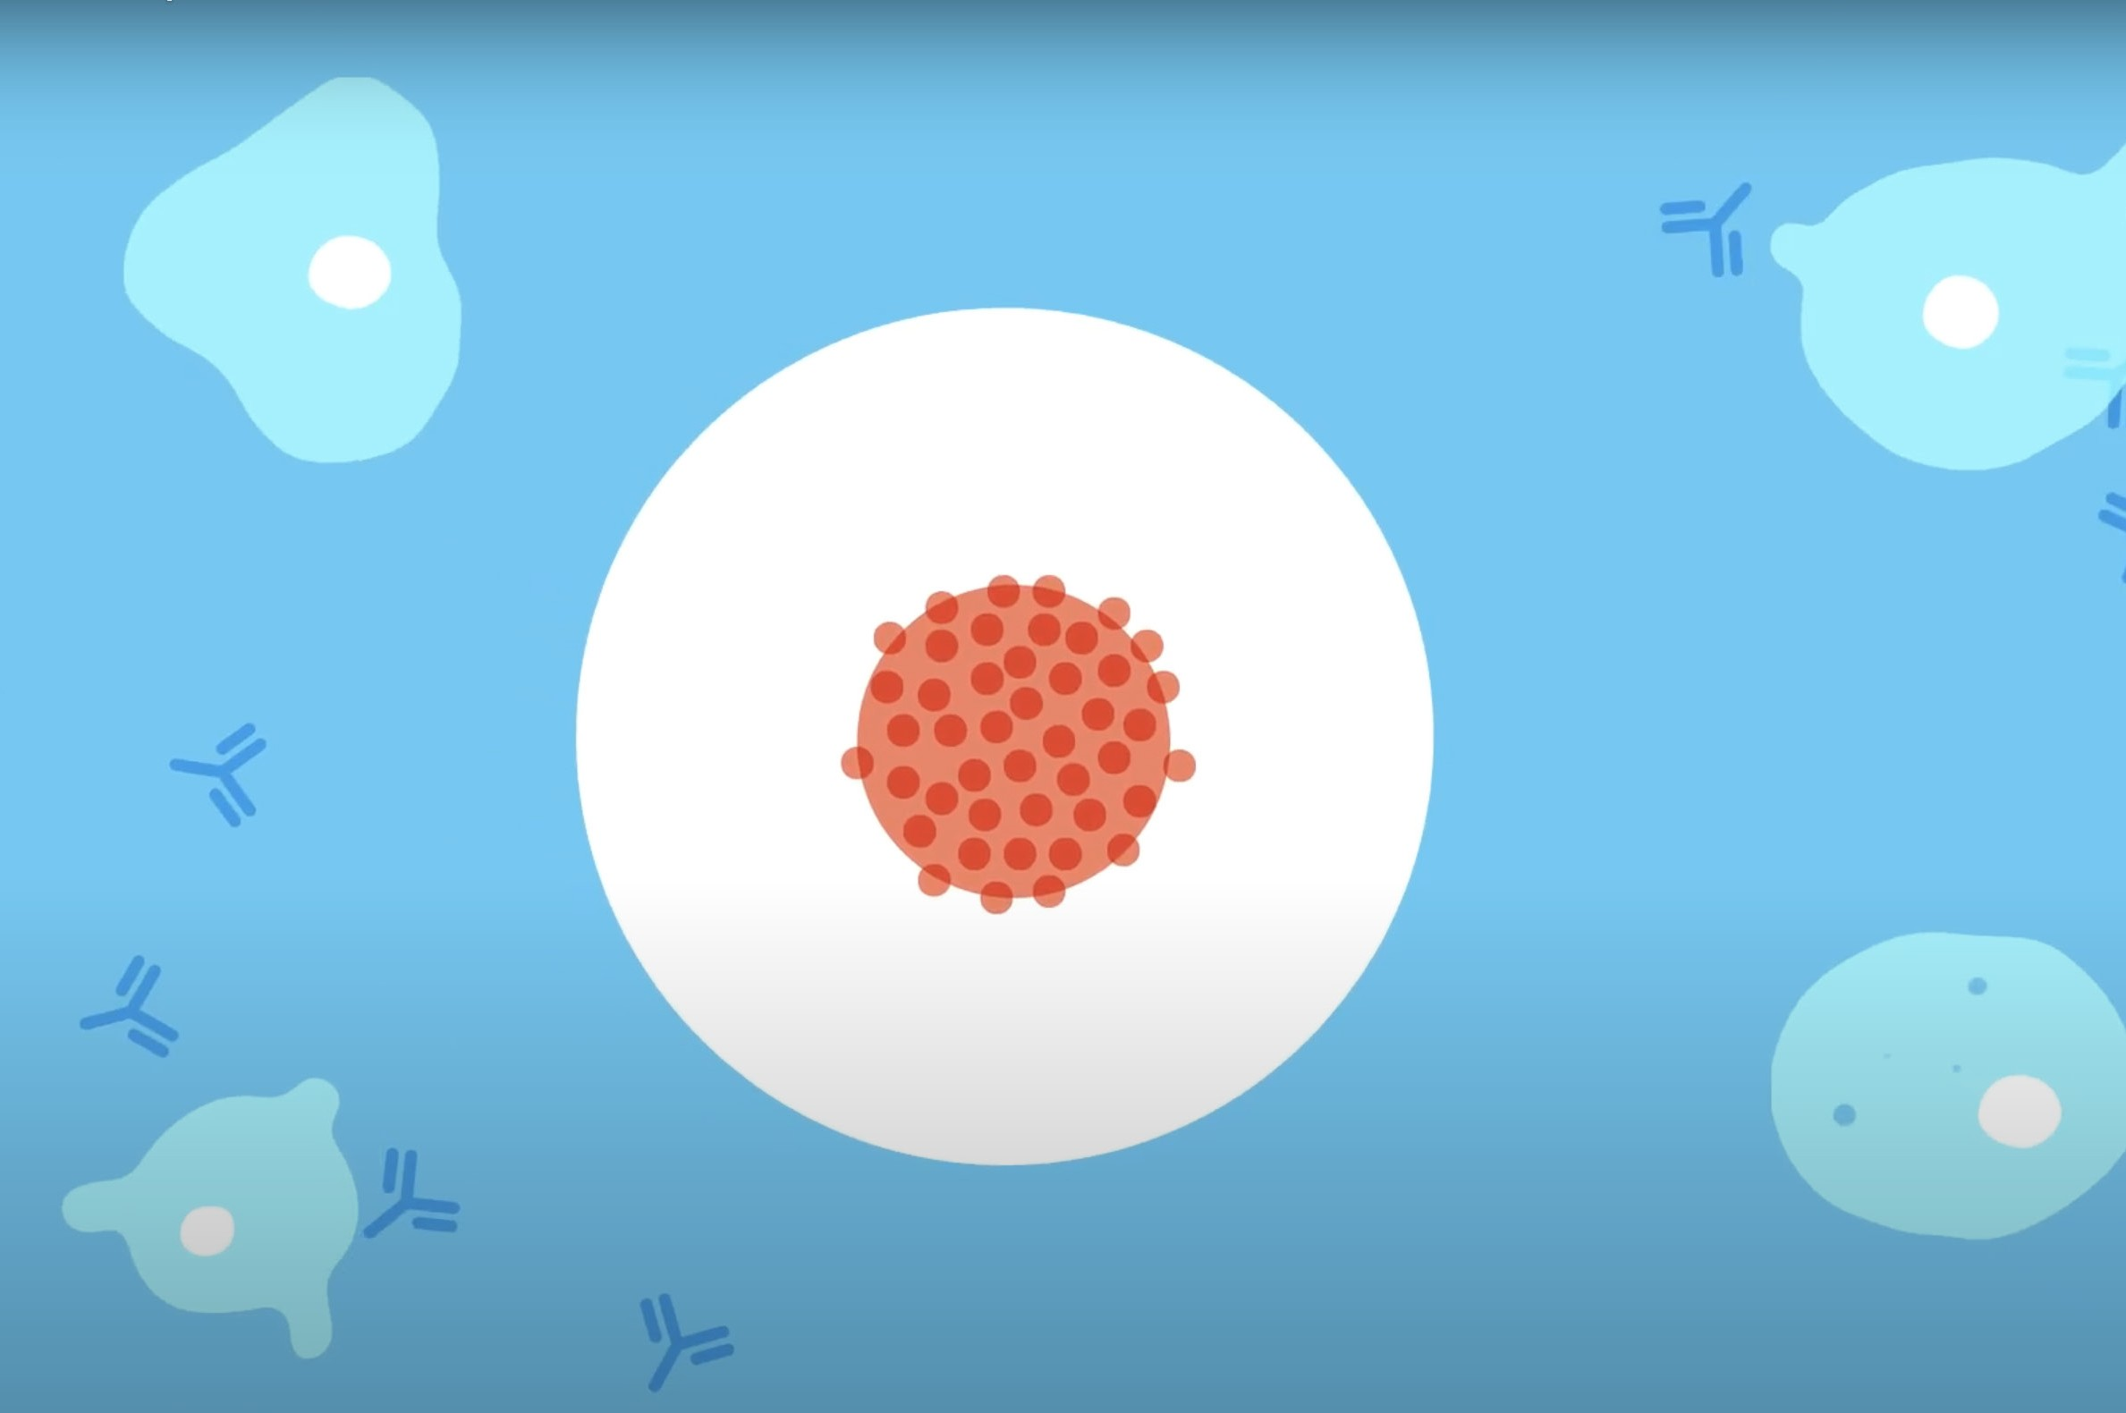


Objective:
To learn about what the HPV vaccine is and what happens on the day of the vaccination
Learning outcomes:
Explain what the HPV vaccine is and how it can provide protection
Identify and challenge misconceptions regarding the HPV vaccine
Describe what happens when someone receives the HPV vaccination
Notes:
Introduction to the lesson
Explain the objectives for the lesson.
Students will be able to
Explain what the HPV vaccine is and how it can provide protection
Identify and challenge misconceptions regarding the HPV vaccine
Describe what happens when someone receives the HPV vaccination

Slide 4
Group agreement:
We will listen to each other
All questions are welcome in this class
If we don’t know the correct terms to use, we will ask the teacher
If something that is said needs to be referred to a member of the safeguarding team, our teacher will do so
Notes:
Introduction to the lesson
The group agreement is included as the package could raise sensitive issues (e.g. sexual behaviours).
This is intended to be discussed with attendees at the beginning, and then confirmed again at the end, of the session.
Young people could also be offered the opportunity to add their own ground rules if they wish.

Slide 5
Group agreement:
We will respect what other
people say
We will ask questions if we aren’t sure of something
We won’t share our own, or our friends’, personal experiences, or share what has been said outside of the classroom.
Notes:
Introduction to the lesson
The group agreement is included as the package could raise sensitive issues (e.g. sexual behaviours).
This is intended to be discussed with attendees at the beginning, and then confirmed again at the end, of the session.
Young people could also be offered the opportunity to add their own ground rules if they wish.

Slide 6
What does HPV stand for?
Notes:
Core Activity One – HPV and the immune system
As an ice-breaker exercise ask the students if anyone knows what HPV stands for. Ask students if anybody has heard of HPV before.
Answer on subsequent slide.

Slide 7
Human Papillomavirus
What does HPV stand for?
Notes:
Core Activity One – HPV and the immune system

Slide 8

What is HPV?
HPV is a virus that can affect everyone
Notes:
Core Activity One – HPV and the immune system
Provide the information about what HPV is.
Explain that there are no symptoms of HPV. Often, someone might not know that they have had HPV, and they might not have any health problems because of it. Symptoms related to cancer may present after many years. However, knowing about what HPV is and how it can appear in the body can help someone to spot early signs and access help if they need it.

Slide 9
What is HPV?
HPV is a virus that can affect everyone
It is spread by skin-to-skin contact, especially in the genital area
Notes:
Core Activity One – HPV and the immune system
Provide the information about what HPV is.
Explain that there are no symptoms of HPV. Often, someone might not know that they have had HPV, and they might not have any health problems because of it. Symptoms related to cancer may present after many years. However, knowing about what HPV is and how it can appear in the body can help someone to spot early signs and access help if they need it.

Slide 10
What is HPV?
HPV is a virus that can affect everyone
It is spread by skin-to-skin contact, especially in the genital area
Usually it leaves the body naturally
Notes:
Core Activity One – HPV and the immune system
Provide the information about what HPV is.
Explain that there are no symptoms of HPV. Often, someone might not know that they have had HPV, and they might not have any health problems because of it. Symptoms related to cancer may present after many years. However, knowing about what HPV is and how it can appear in the body can help someone to spot early signs and access help if they need it.

Slide 11
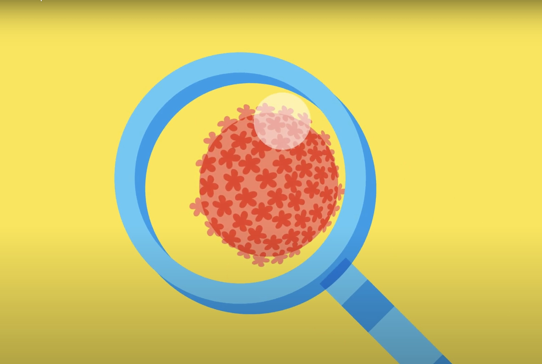
How common is HPV?
It is very common
Without a vaccination programme, 4 in 5 people will be infected with HPV over their lifetime
Notes:
Core Activity One – HPV and the immune system

Slide 12


HPV and the immune system
Notes:
Core Activity One – HPV and the immune system
Play the animation (Film One) to the students. It covers key information and questions young people may have about HPV and the immune system.
Provide young people with the questions provided in Activity One worksheet to complete while the video is being played. You may wish to pause the video to allow for students to complete the worksheet.
Questions
What happens if an infection with HPV does not clear naturally?
How can someone find out if they have HPV?
Is there a cure for HPV?
How can someone protect themselves from HPV?

Slide 13
Activity: HPV and the immune system
What happens if an infection with HPV does not clear naturally?
How can someone find out if they have HPV?
Is there a cure for HPV?
How can someone protect themselves from HPV?
Notes:
Core Activity One – HPV and the immune system
After the video has been played, ask volunteers to share their answers to the four questions.
1) What happens if an infection with HPV does not clear naturally?
Persistent infection with HPV can lead to genital warts and cancers affecting the mouth, throat, anal and genital areas of men and women.
2) How can someone find out if they have HPV?
Most of the time people do not know they have HPV. Women can get tested when they attend for their cervical cancer screening programme.
3) Is there a cure for HPV?
There is no cure for HPV. However, there are treatments for the effects of HPV.
4) How can someone protect themselves from HPV?
Having the HPV vaccine is the best way to be protected from HPV.

Slide 14
Activity: HPV-related illnesses
Use the information on the posters to help you and a partner respond to the questions from students wanting know all about the vaccine.
Give them as much information as you can to help reassure them!
Notes:
Core Activity Two – HPV-related illnesses
Distribute the information on Activity Two - Resource A around the classroom. Working in pairs, ask students to use this information to complete Activity Two - Resource B by moving around the room to find the information that they need to respond to the questions on their worksheet.
If space does not allow, you may wish to ask students to rotate the information across their tables, spending two to three minutes with each sheet of information.

Slide 15
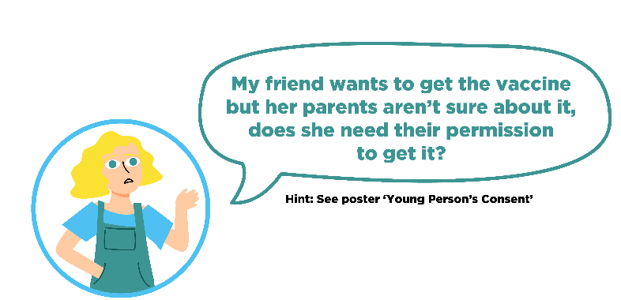
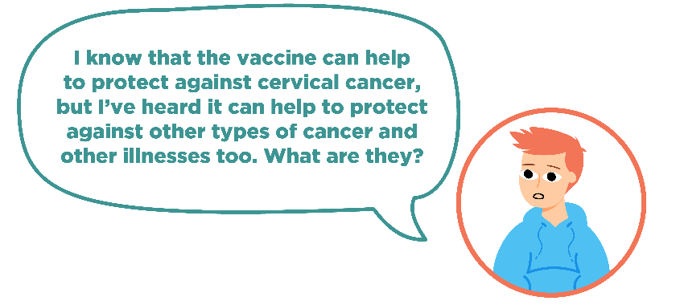
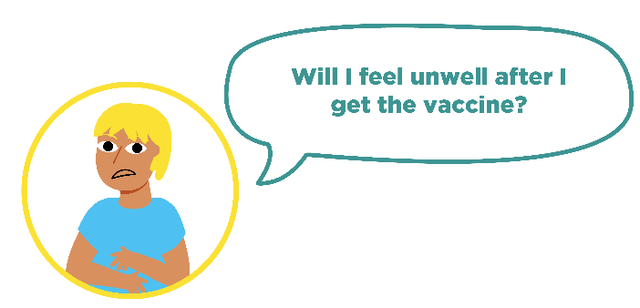
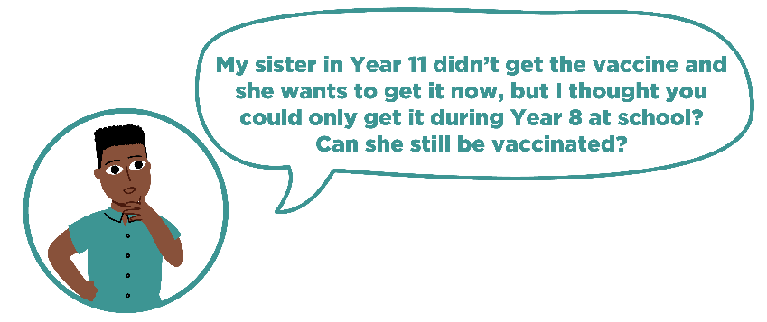
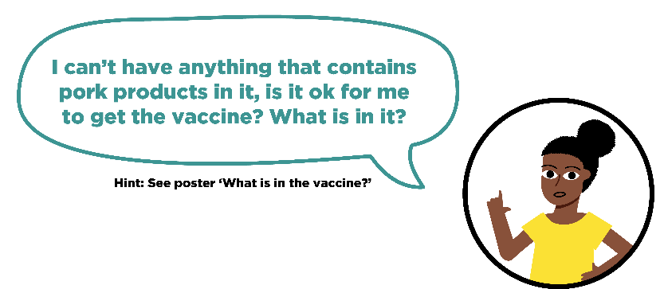
Activity: HPV-related illnesses
Notes:
Core Activity Two – HPV-related illnesses
When the students have completed the worksheet, ask volunteers to share their responses to each of the questions presented by the ‘talking heads’.
If there are any student questions at this stage, please see the accompanying Frequently Asked Questions for teachers document and suggested responses.

Slide 16

Questions with an immunisation nurse
Notes:
Core Activity Two – HPV-related illnesses
Optional activity
Film Two. Questions and answers with an immunisation nurse
Play this film which shows young people asking the immunisation nurse their questions about vaccination.

Slide 17
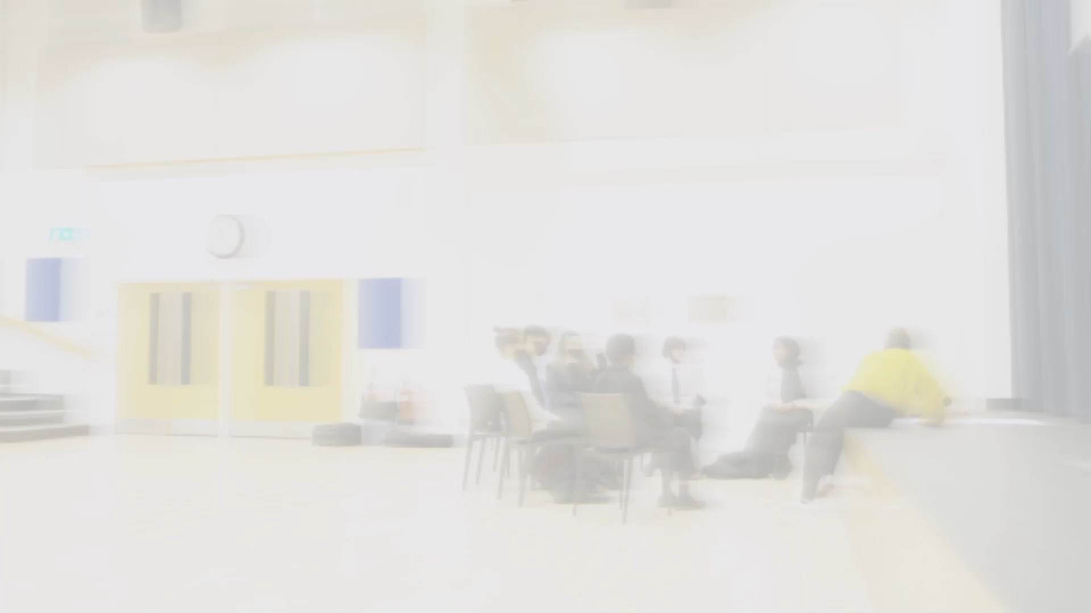
What to expect at the HPV vaccine session
Notes:
Core Activity Three – HPV vaccination programme
Show Film 3 (What to expect at the HPV vaccine session) to introduce the students to the activity. After the film is shown, provide context specific information about how the session will run in their school. For example:
Date of vaccination session
Consent procedure
Location of vaccination session

Slide 18
Tips for the day of the vaccination
If someone is feeling nervous, they can ask to be vaccinated first
Keep distracted
Talk to the person giving the vaccine
Notes:
Stress to young people that they shouldn’t worry. It won’t be as bad as they think and the nurses are really nice. Young people say that the worst bit is waiting around for the vaccine beforehand.
It’s a sharp scratch for hardly any time all. Then you will know you’re protected against the main types of HPV.
If the young person is feeling a bit nervous they could be encouraged to tell their teacher to see if they can have the vaccine before the other students.
Other tips include taking some big deep breaths to keep feeling calm and distract themselves. Or they could try counting backwards from 100.
Young people could be invited to provide their own tips for having the vaccination session.

Slide 19
Tips for the day of the vaccination
Eat something before having the vaccine
Wear a short sleeved or loose sleeved top
If someone wears a long sleeved top, they don’t need to worry. Everyone’s privacy will be protected
Notes:
Stress to young people that they shouldn’t worry. It won’t be as bad as they think and the nurses are really nice. Young people say that the worst bit is waiting around for the vaccine beforehand.
It’s a sharp scratch for hardly any time all. Then you will know you’re protected against the main types of HPV.
If the young person is feeling a bit nervous they could be encouraged to tell their teacher to see if they can have the vaccine before the other students.
Other tips include taking some big deep breaths to keep feeling calm and distract themselves. Or they could try counting backwards from 100.
Young people could be invited to provide their own tips for having the vaccination session.

Slide 20
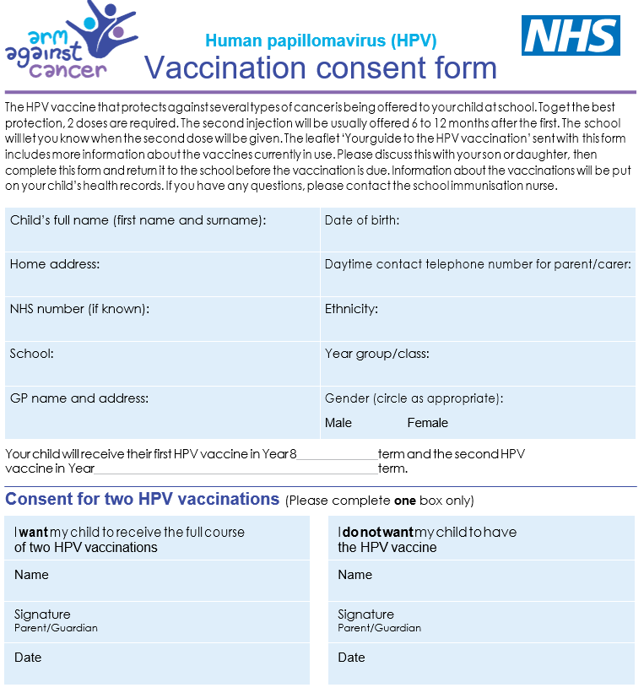
Getting the vaccine
Information leaflets and consent forms will be provided (either electronically or paper) by the school
Parents/carers are asked to complete
the consent form and return it to the school
Notes:
Core Activity Three – HPV vaccination programme
If possible, this session could be provided at the time consent forms are being distributed. If paper-based consent forms are used, these could be provided during the session.
Young people could be informed about any school specific instructions at this point (e.g. name of staff member co-ordinating the session).

Slide 21
Exercise: On the day of the vaccine
Create a short storyboard in your book to show what happens on the day of the HPV vaccination session.
Use three boxes to draw a simple illustration showing what happens before, during, and after the HPV vaccination session. In your drawing, or in a short description for each part of the storyboard, make sure you’ve included:
A consent form being signed and given into school
The nurse explaining what will happen
The vaccine going into the top of the arm
The student going back to class (perhaps with their arm feeling a little bit sore!)
Notes:
Core Activity Three – HPV vaccination programme
Provide the students with Activity Three – Worksheet. Ask students to create a short storyboard demonstrating what happens on the day of the vaccination. The storyboard should contain three stages: what happens before the vaccination, what happens during the vaccination, and what happens after the vaccination.
Ask students to make sure that within their storyboard, they have included key stages such as:
- a consent form is signed and given to school
- the nurses will explain what happens
- the vaccine goes into the top of the arm
- arm might feel a bit sore
- students return to the rest of their day.
Once they have finished their storyboard, they should add at least two top tips for peers to help them stay calm when they have the vaccine.
When students have completed their work, ask them to swap their storyboard with a partner’s, and check that they have included the key aspects. If they have missed any, ask them to leave comment for what they can include, as well as a positive comment on what their partner has done well.
Hint: Provide key words for students to use to help them create their storyboard, thinking carefully about which key words would fit in each part of the storyboard (key words might include: consent form, queue, nurse, distraction, sore arm, protection)

Slide 22

Reassurance strategies
Notes:
Core Activity Three – HPV vaccination programme
Optional activity
Play the film. It covers young people providing suggestions for how to improve their experience of having the HPV vaccine.

Slide 23
What have we learned?
1. What are three reasons that young people should get the vaccine?
2. What are two facts about HPV that are important to know?
3. What is one piece of advice that can help Micah feel better about getting the vaccine?
Notes:
End point assessment
Provide student with the Endpoint Assessment worksheet. Ask the students to write their responses in the spaces provided.
This is the final chance for young people to ask any questions they may have.
It may be worth iterating the key points about the HPV vaccine at this stage.
HPV is a very common infection that can in some cases lead to cancer.
The HPV vaccine is a safe and effective vaccine.
Getting the HPV vaccine will provide young people with protection from the strains of HPV that cause the majority of cases of cancer.

Slide 24
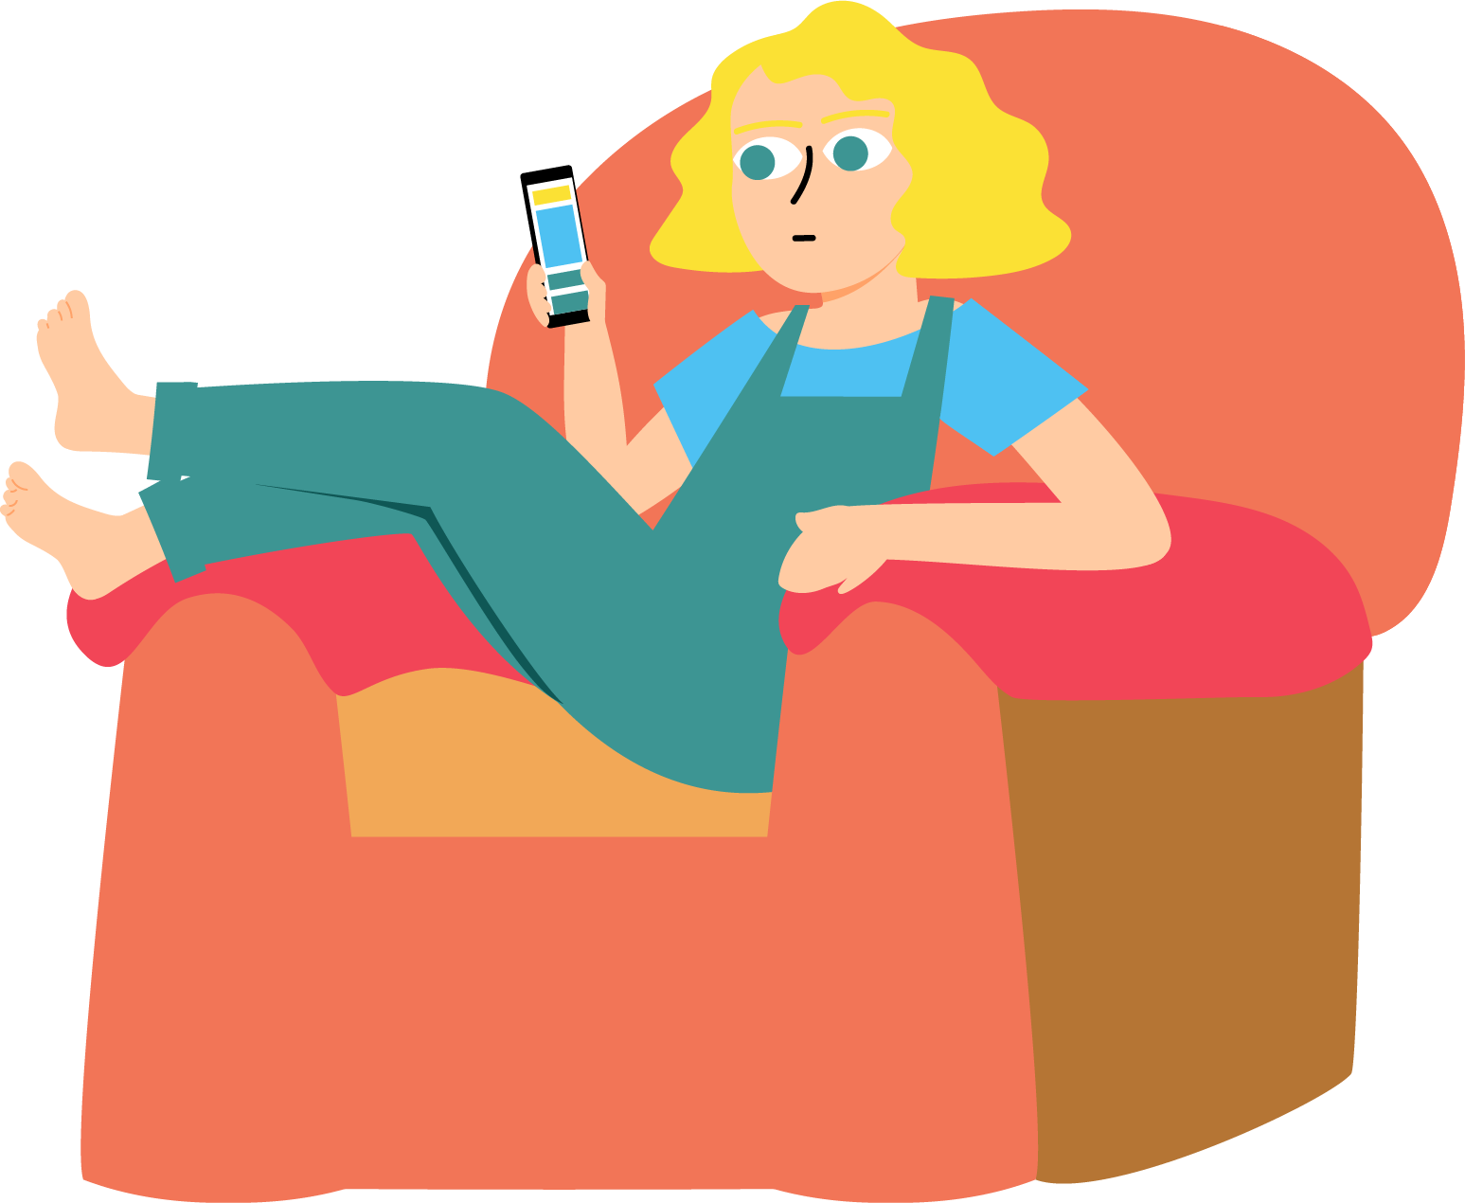
For more information about the HPV vaccine
Ask me any questions you
may have now
Speak to your school nurse or medical officer
Visit: www.healthforteens.co.uk
Speak to the doctor at your local GP surgery
Notes:
Signpost towards further support
Ensure students are aware of where they can get more information about the HPV vaccine if they want it.
Inform students that they can speak to the teacher after the lesson, or the school nurse/medical officer in the school. They can also speak to their GP if they want to speak to somebody out of school.
Ensure that the anonymous question box is checked at the end of this lesson. Any questions about the content should be followed up as soon as possible; in the following PSHE lesson if not before.
Students could be provided with HPV vaccine leaflets during the lesson. The UK Health Security Agency publish the HPV vaccine leaflet: https://www.gov.uk/government/publications/hpv-vaccine-vaccination-guide-leaflet
On the website there is also information available in the following languages:
Albanian, Arabic, Bengali, Brazilian Portuguese, Bulgarian, Chinese, Estonian, Farsi, Greek, Gujarati, Hindi, Latvian, Lithuanian, Panjabi, Polish, Romanian, Romany, Russian, Somali, Spanish, Turkish, Twi, Ukrainian, Urdu and Yiddish.
There is a British Sign Language (BSL) video of this leaflet available to download.

Slide 25









The presentation was created as part of the EDUCATE study by researchers at the University of Bristol and London School of Hygiene and Tropical Medicine in collaboration with our partner organisations.

