Slide 1
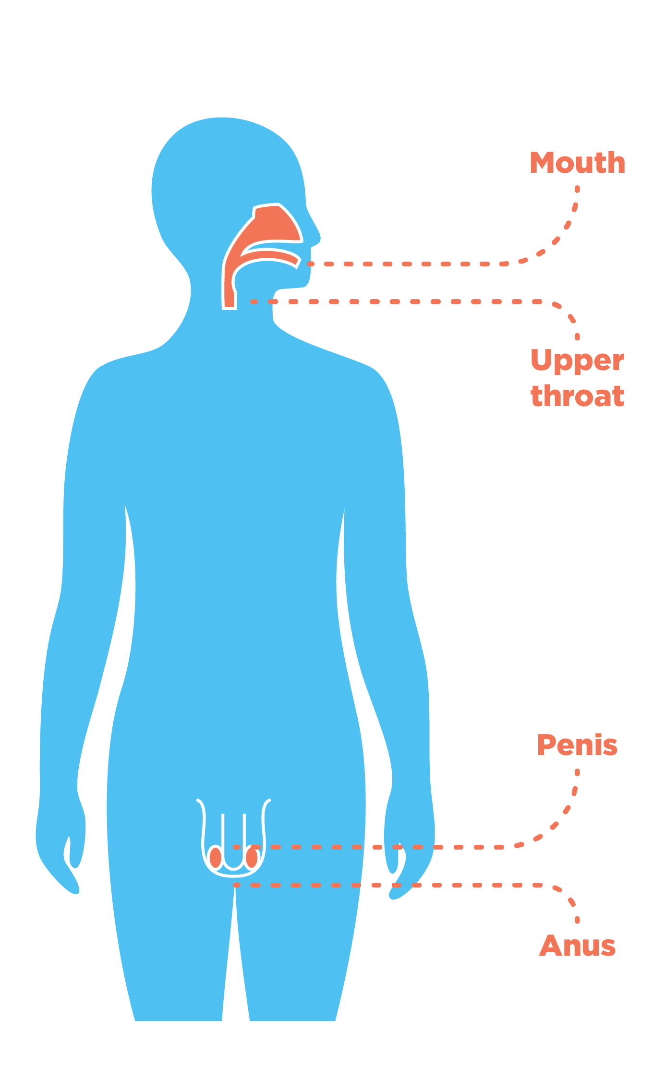
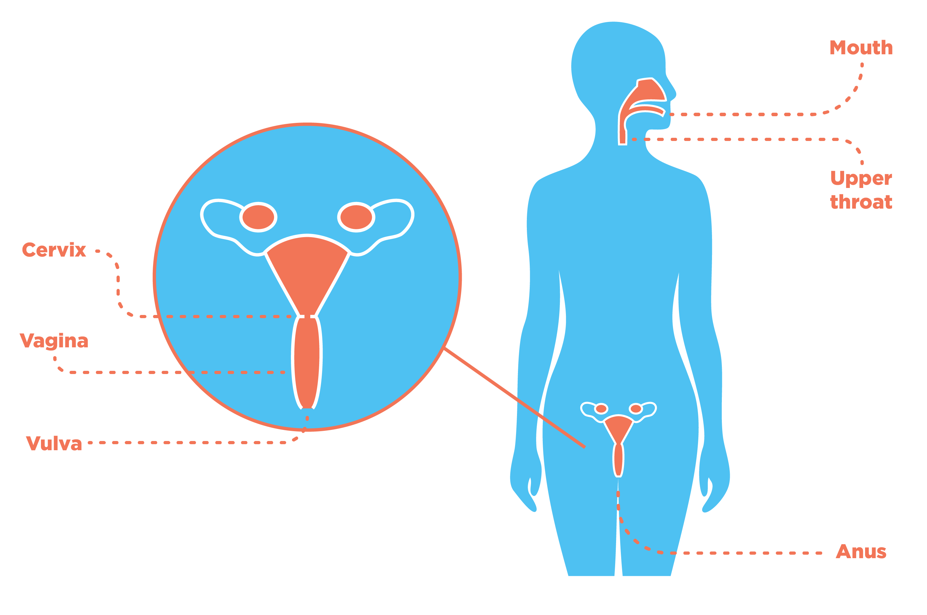

Body parts affected by HPV-related cancers
Cervical cancer is the most commonly occurring HPV-related cancer
Notes:
HPV related cancers include:
Cervical cancer
Vaginal cancer
Vulval cancer
Anal cancer
Cancer of the penis
Some cancers of the head and neck
Cervical cancer is the most widely occurring HPV-related cancer.
Often young people are unclear where the cervix is. This can be clarified during the session through the close up of female anatomy.

Slide 2
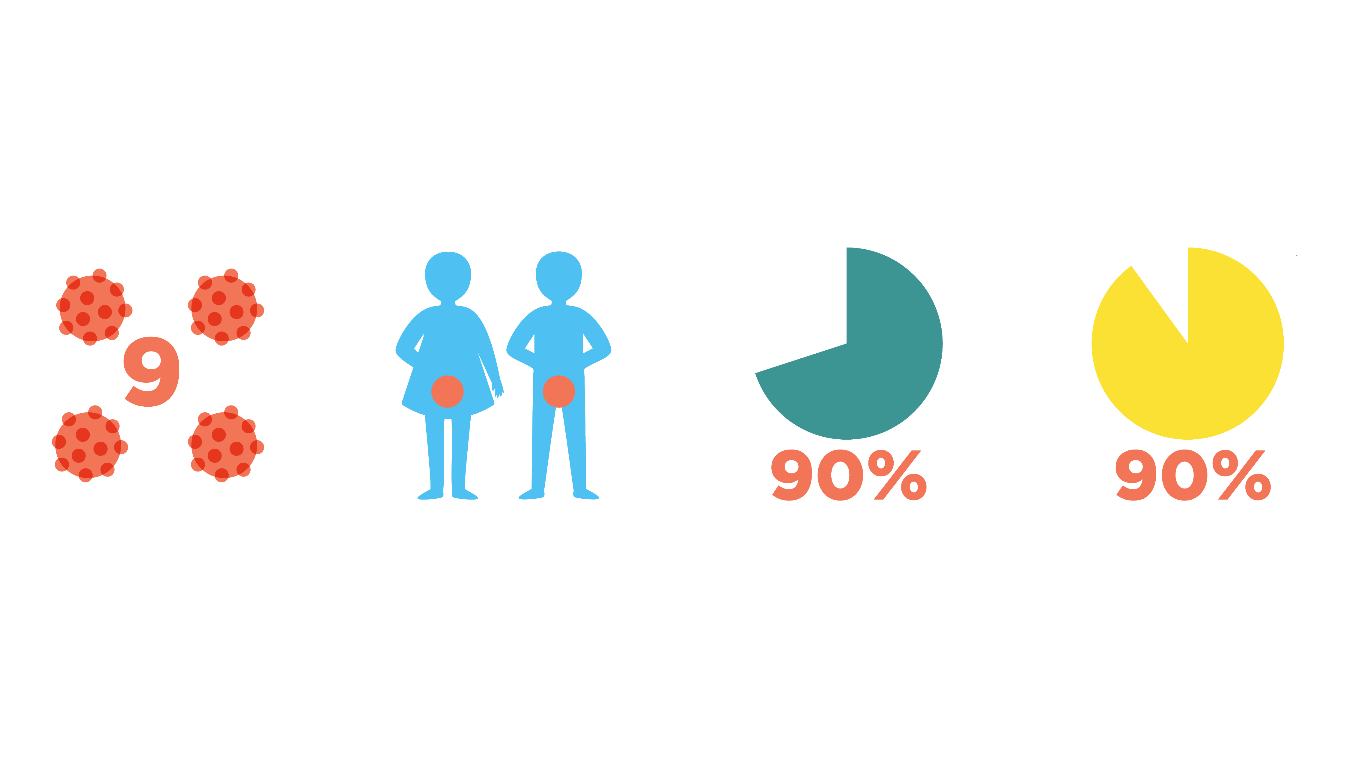
What does the HPV vaccine protect against?
The nine strains of HPV that cause most cases of cancer
Mouth, throat and genital cancers
90% of cases of cervical cancer
90% of cases of
genital warts
In the majority of cases, an infection with HPV will clear without symptoms.

Slide 3


What is in the vaccine?
The vaccine contains particles which look like the outside of the real HPV
It also contains some other ingredients to make the vaccine suitable for injection
The vaccine does not
contain pork or gelatine

Slide 4
Is the vaccine safe?
Yes, the vaccine is safe.
Millions of doses have been given worldwide.

Slide 5



How effective is the HPV vaccine?
It is a very effective vaccine
It will prevent 99% of infections caused by the strains of HPV it protects against
Notes:
The HPV vaccine is one of the most effective vaccines available.

Slide 6
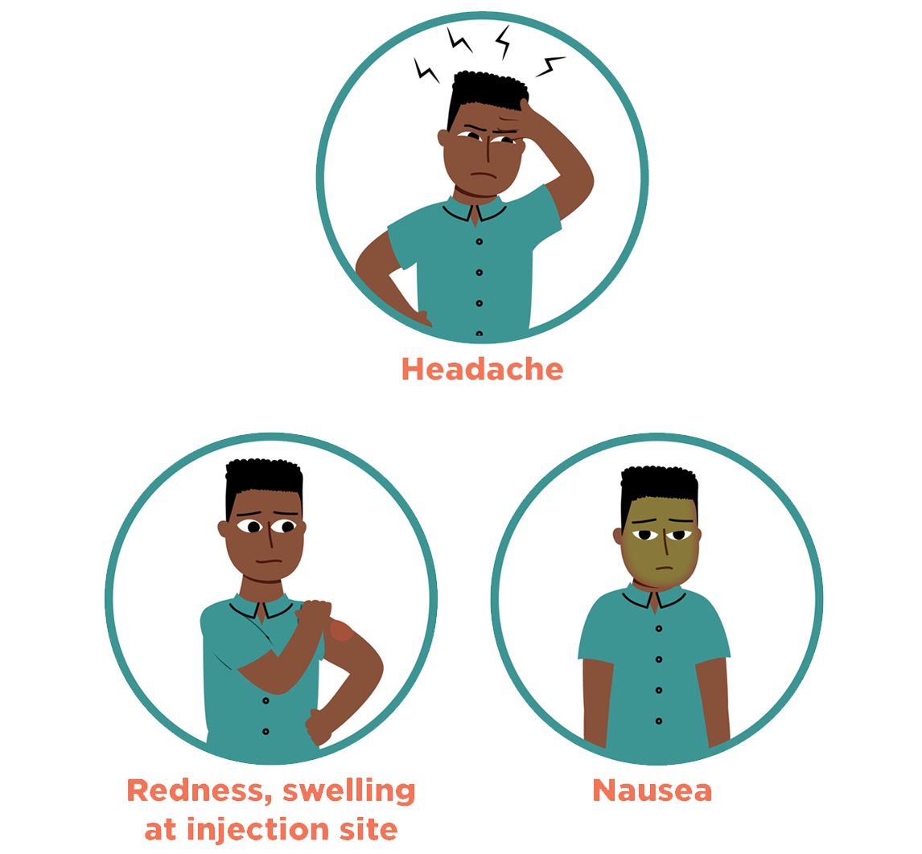
Are there any side-effects?
There might be some minor side-effects
These are normal and shouldn’t last more than a day or two
Only around 1 in 100 people will develop nausea

Slide 7
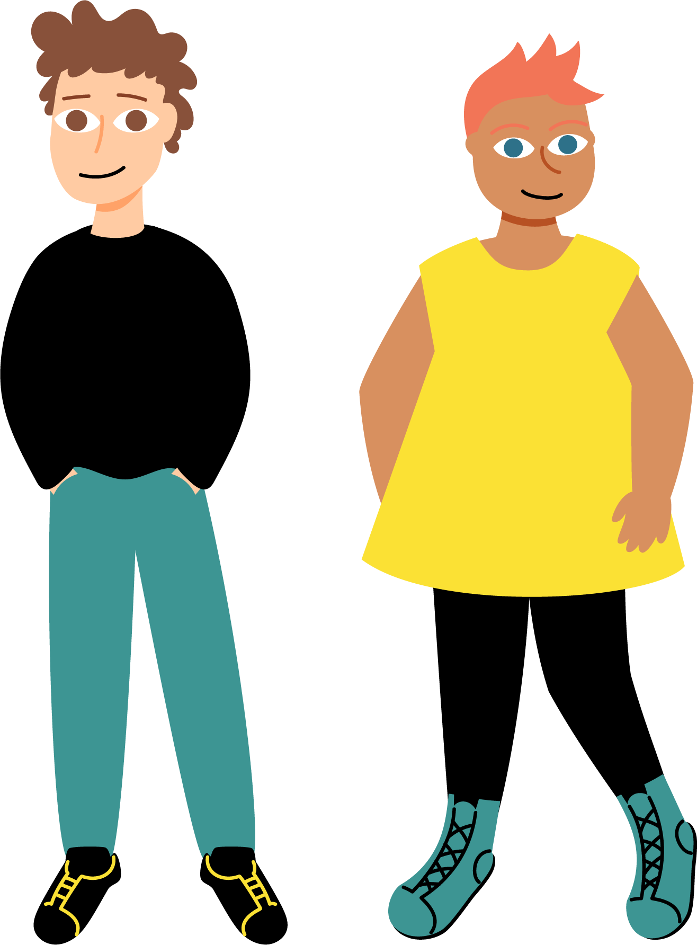

Who can have the HPV vaccine?
Students are offered the HPV vaccine early in secondary school as this is a good time to have it
If someone misses having the vaccine at school, they can also have the HPV vaccine at their general practice until they are 25 years old
The vaccine is also available for men-who- have-sex-with-men until they are aged 45 years

Slide 8
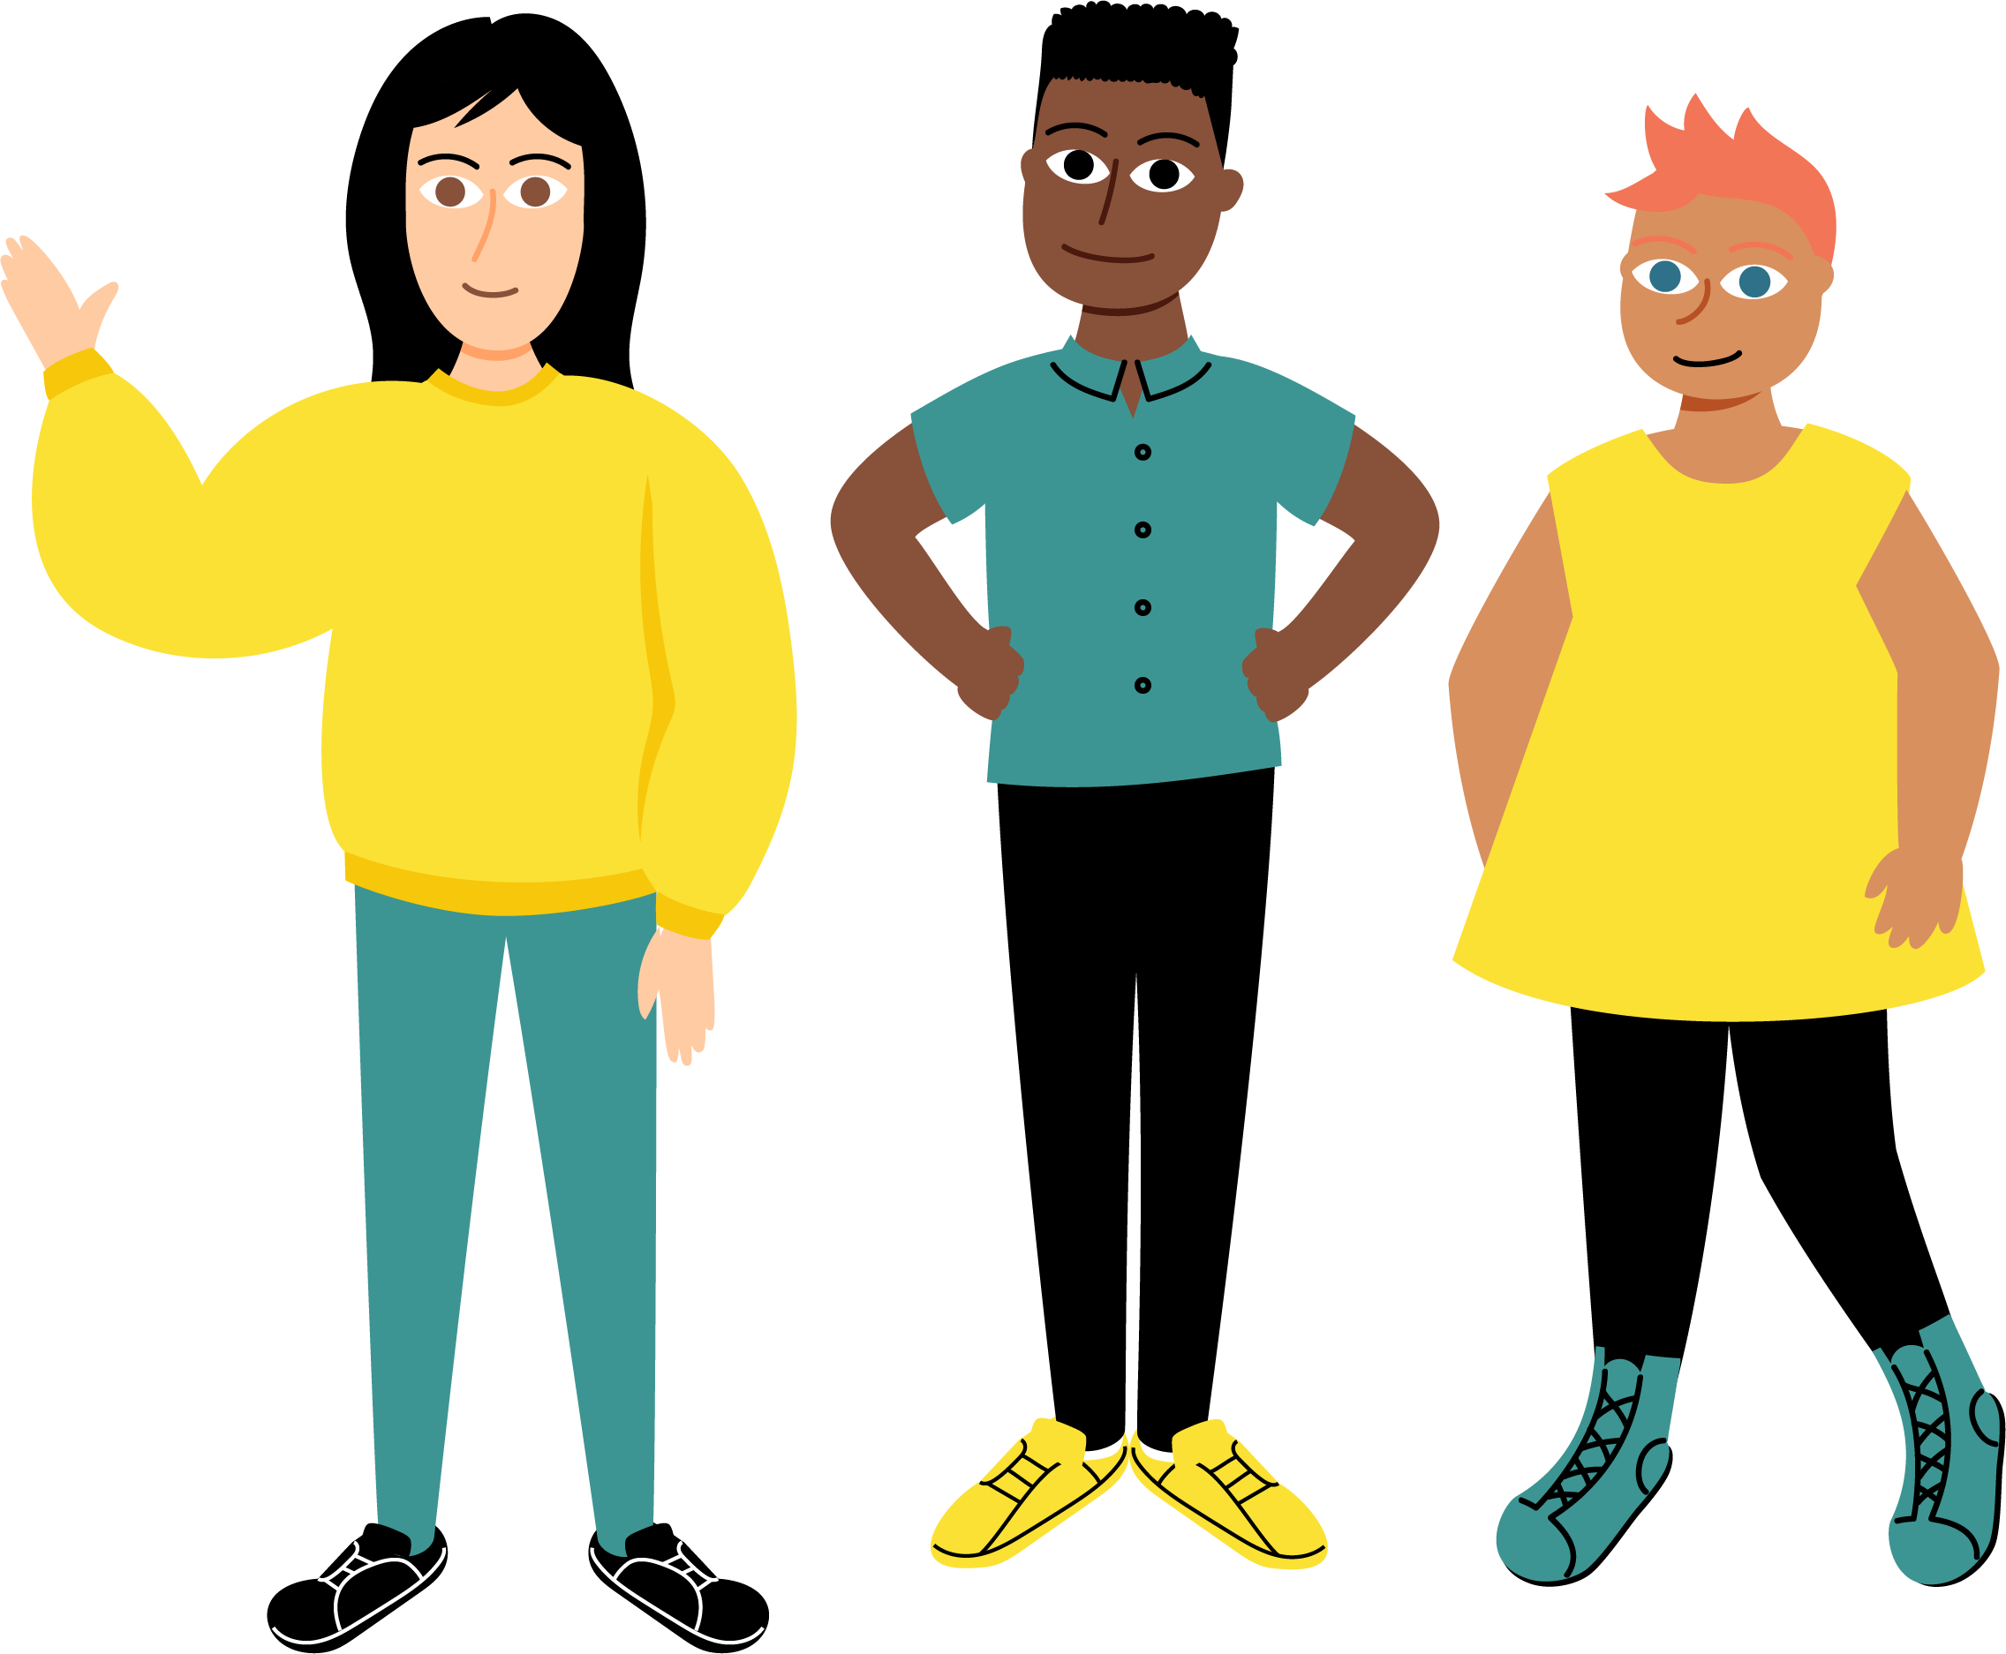
Young people’s consent
We recommend young people get agreement from their parent/carer, but it isn’t always necessary
For more information about young people’s consent, young people can talk to their school nurse / medical officer

Slide 9
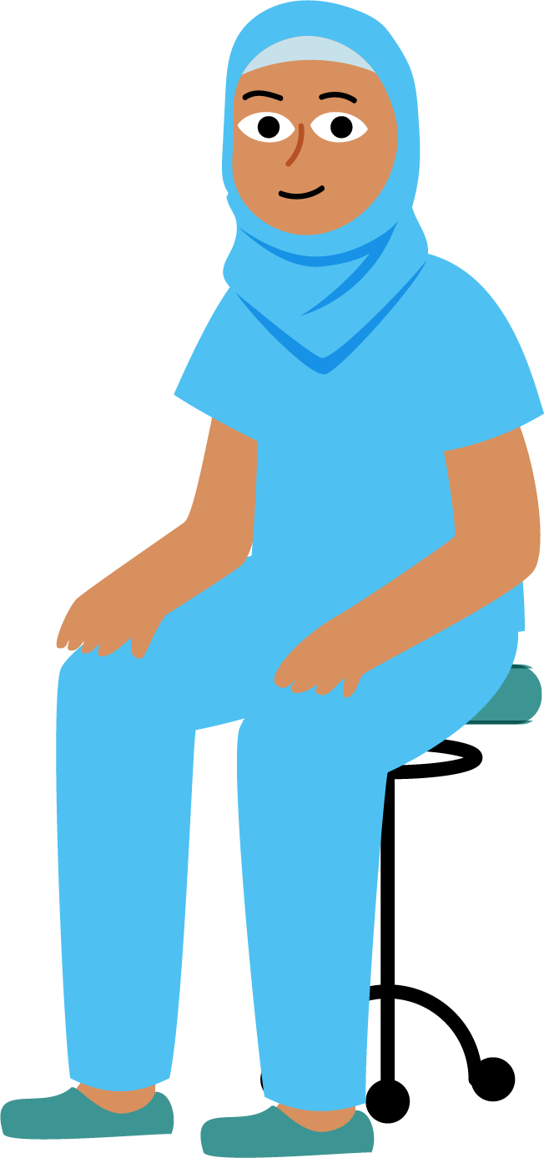
What should someone do if they miss having the vaccine at school?
If someone misses the vaccine at school, they can talk to the school or their parents/carers about arranging to have it
Young people can catch up right up until their 25th birthday
Visit the immunisation team at a clinic or general practice

